Slide 1


REF2021: impact and strategies for St George’s
Jodi Lindsay
Academic Lead for REF2021
Update Feb 2020
The slides are deposited on the SGUL website
https://www.sgul.ac.uk/research/our-impact/research-excellence-framework/ref-2021

Slide 2
Overview Update
What is REF and what does REF mean to SGUL? Income and reputation
What is assessed and how?
Which staff will be submitted?
Output papers
Which papers will we submit?
Mock REF (currently open)
What is an eligible paper?
What if there are multiple SGUL authors on a paper?
How is the quality of papers assessed?
Next steps
Impact cases
Environment
Summary and contacts

Slide 3
Research Excellence Framework (REF)
http://www.ref.ac.uk/
REF is the system for assessing the quality of research in UK universities and higher education colleges.
The key purposes of the REF are:
to inform the selective allocation of funding for research
to provide accountability for public investment in research and produce evidence of the benefits of this investment
to provide benchmarking information and establish reputational yardsticks, for use in the higher education sector and for public information.
Managed by Research England.
REF (or RAE) is held every 6-7 years, and the outcome determines funding until the next exercise
The budget for distribution is approx. £2 billion, this money is designed to underpin research.

Slide 4
We are assessed on
- Outputs (publications) (60%) – originality, significance, rigour
- Impact cases (25%) – Social, economic, cultural impact of our research
- Environment (15%) – resources and infrastructure
Assessments are subject specific. There are 4 panels and 34 Units of Assessment. SGUL will submit to Panel A in 2 Units of Assessment.
- Clinical Medicine (UoA1)
- Public Health, Health Services and Primary Care (UoA2)
Each Output, Impact case or Environment submission is assessed as either
4*, 3*, 2*, 1* or unclassified
Assessment panels will work through 2021
The full guidance is at www.ref.ac.uk
- Prof Dot Bennett (MCS) is on UoA5 (Biological Sciences) panel
- Prof Mary Chambers (Joint Faculty) is on UoA3 (Allied Health Professions,
Dentistry, Nursing, Pharmacy)

Slide 5

What does REF mean for St George’s?
Income
In 2017/18, our income from based on our REF2014 results (mainstream QR funding) is nearly £1.7 million.
Reputation
Results are published in full http://results.ref.ac.uk/
Analysis of these results is interpreted in multiple ways in a variety of locations
– e.g.
The Times Higher Education (THE) rankings
The Guardian
FindaPhd

Slide 6
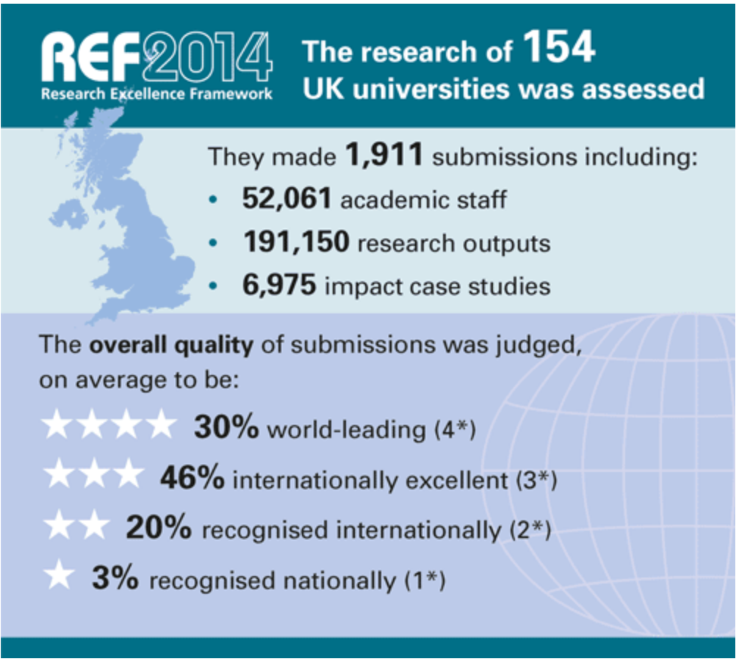
https://www.ref.ac.uk/2014/

Slide 7
Introduction to HEFCE mainstream QR funding
Income
HEFCE mainstream QR funding is allocated based on
  quality assessed via REF 2014, where 4* world-leading is weighted 4 and 3* internationally excellent is weighted 1
  volume submit in REF (FTE of R-active staff) * proportion meeting quality threshold
  relative costs by subject area (lab=1.6, others=1.3 or 1.0)
  London weighting (currently 12% for St George’s)
Calculations are separate for OUTPUTS, ENVIRONMENT and QUALITY areas of REF
HEIs also get QR for Business Research and Charity Support (bit like an overhead) and HEIF (knowledge exchange funding)
Julie Leeming, Director of Planning

Slide 8
HEFCE QR funding to St George’s 2017-18
Income
Julie Leeming, Director of Planning

Slide 9
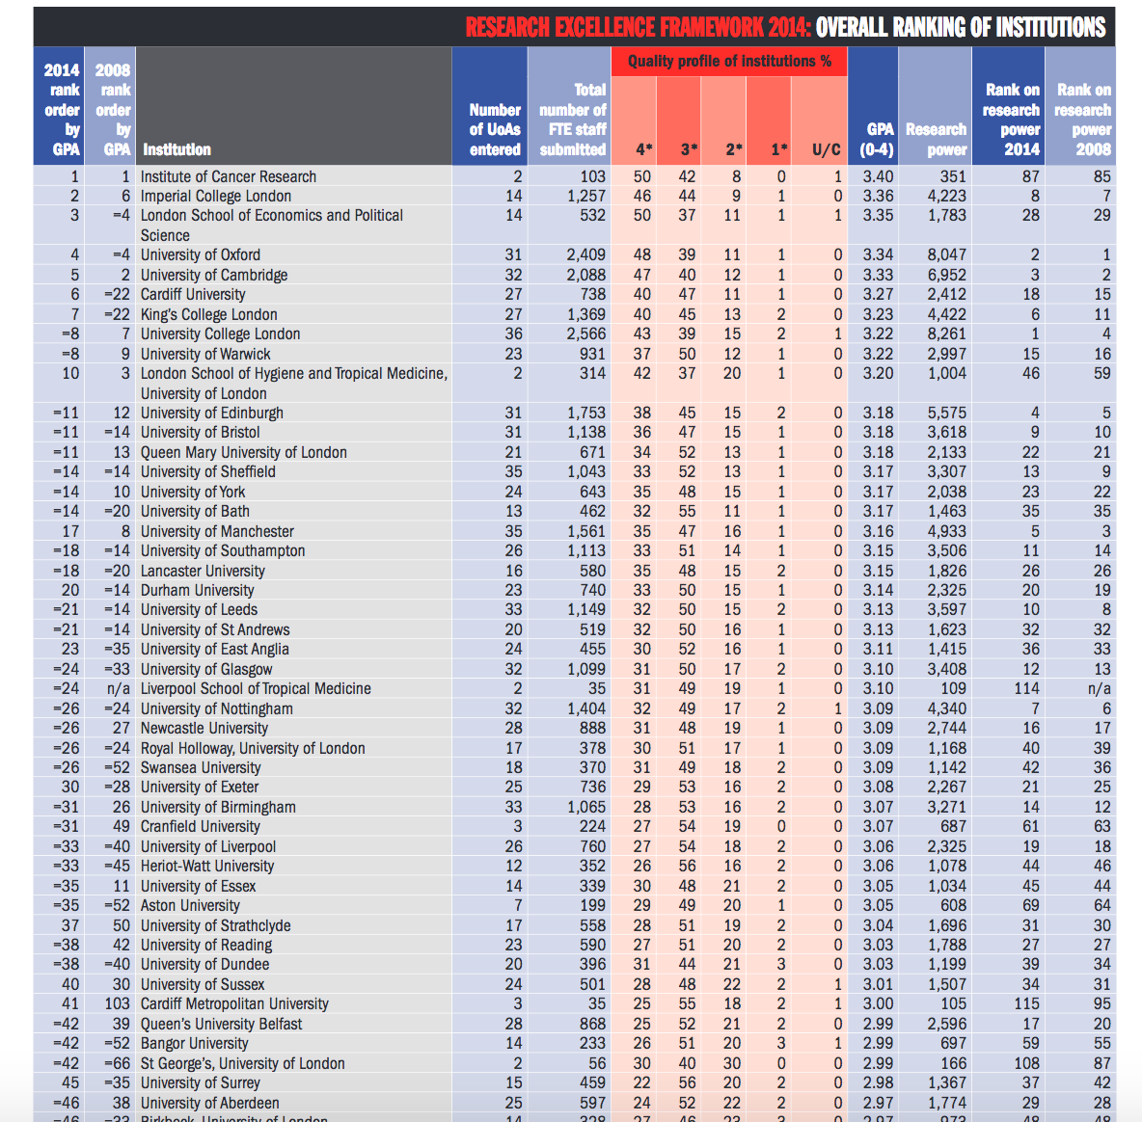
Reputation
The Times
Higher Education
(THE)
Overall –
SGUL = =42/128
(increased since
REF2008)
Assessed by GPA
(mean * score per
assessment)
Research power
(GPA x FTE)
Rank = 108/128

Slide 10
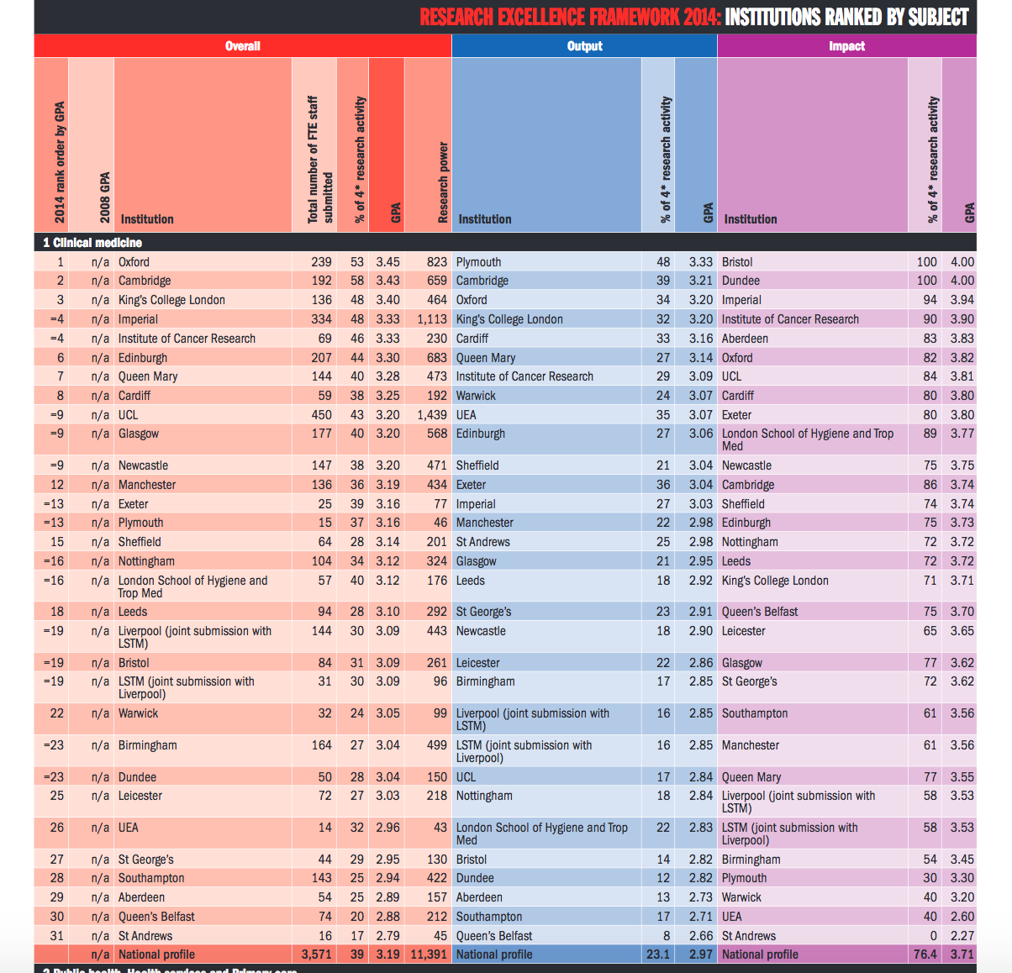
The Times
Higher Education
(THE)
Subject specific
St George’s rank
for UoA1
Clinical Medicine
Overall = 27/31
Outputs = 18/31
Impact = 21/31

Slide 11
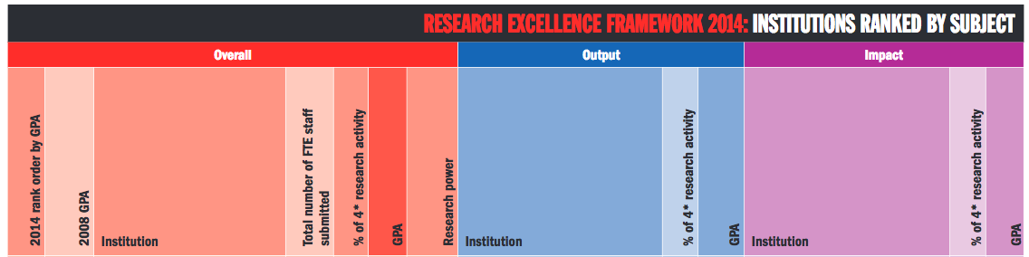
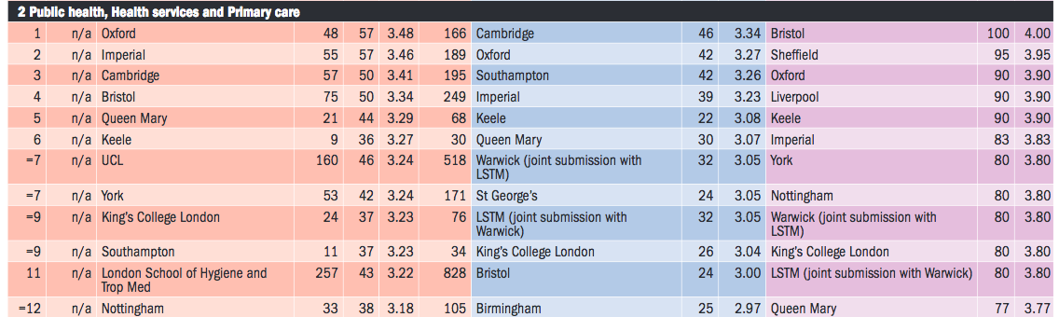
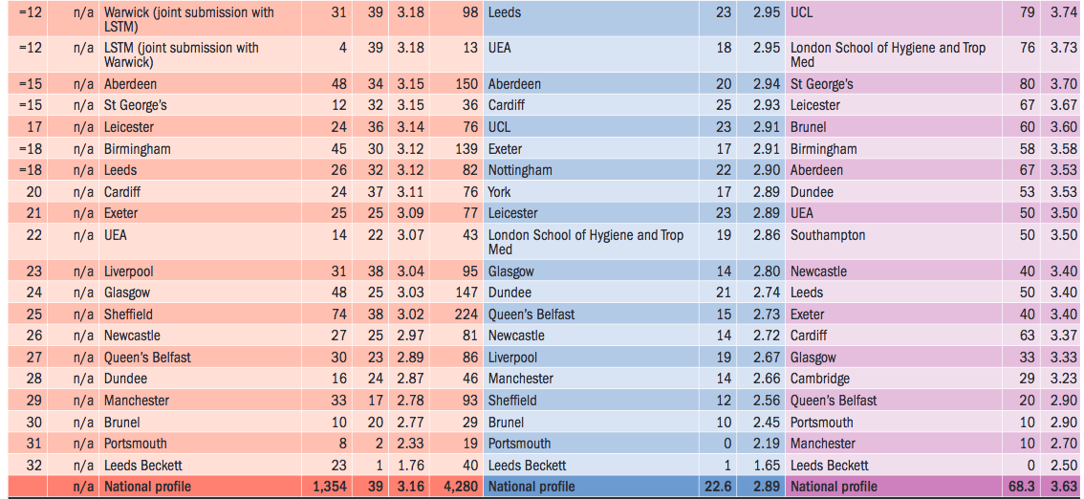
The Times
Higher Education
(THE)
Subject specific
St George’s rank
for UoA2
Public Health,
Health Services &
Primary Care
Overall = =15/32
Outputs = =7/32
Impact = 14/32

Slide 12
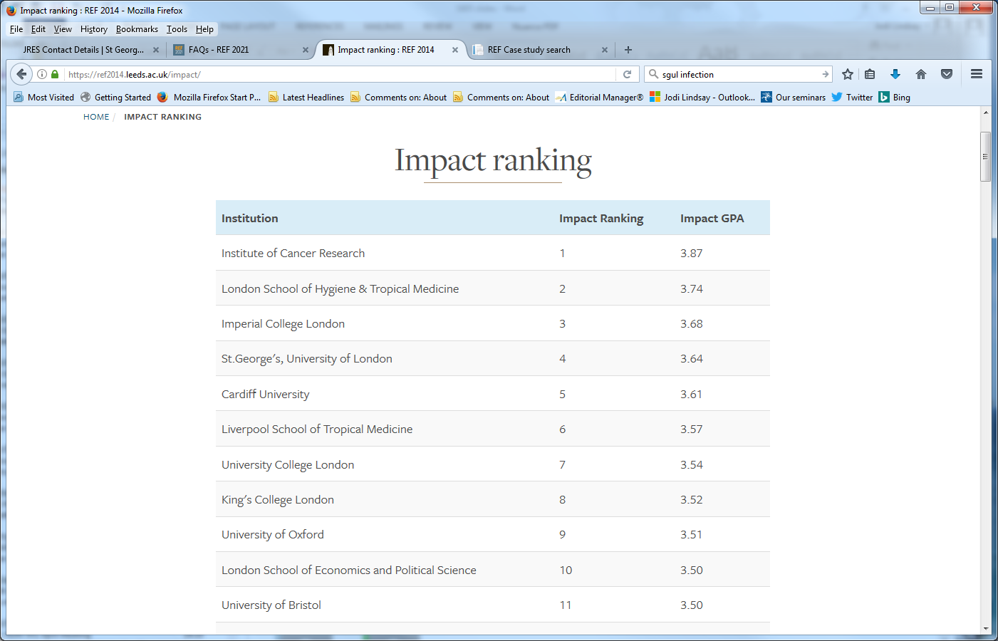
SGUL ranked 4th overall for Impact

Slide 13
What’s new for REF2021?
Consultation – Stern review 2016
In REF2014, only a selection of research active academics were returned, each having 4 quality outputs (papers). It was felt this was an assessment of academics rather than institutions.
In REF2014, each academic was returned by the institution employing them on the census date in 2013. This led to a marketplace for academics with 4* papers, and not enough credit to universities that developed academic careers.
Important changes this time
- Staff eligibility
- Portability of staff

Slide 14

Which staff are eligible for REF submission?
SGUL’s Strategy is documented in our Code of Practice (approved by REF2021)
All academics who
Have a Significant responsibility for research
(at SGUL : are a Member or Joint Member of a Research Institute)
Are ‘independent’
(at SGUL: job title is Lecturer, SL, Reader, Prof or holder of an independent fellowship post-PhD)
Employed by SGUL at least 0.2 FTE on the census date of 31 July 2020
SGUL will submit approx. :
UoA1 (Clinical Medicine) – 94 FTE
UoA2 (Public Health) – 18 FTE

Slide 15

New Rules for REF2021 – portability
If a member of staff was eligible for REF but has left, retired, etc. and is not employed on the census date of 31 July 2020, they are not included in the FTE.
But, outputs and impact cases generated while that staff member was employed at St George’s can be submitted.
New staff employed on the census date count towards our FTE and we can include their outputs.
We can include their impact cases if the impact was generated by SGUL.

Slide 16

Outputs
Numbers of outputs
All REF2021 eligible academics must submit at least one output (paper)
The maximum number of papers submitted by one academic is five.
The total number of papers submitted will be 2.5 x FTE
SGUL will submit approx. :
UoA1 (Clinical Medicine) – 235 papers
UoA2 (Public Health) – 45 papers

Slide 17
Outputs
The Mock REF Feb 2020 – have your say in how we choose your Outputs
SGUL’s Mock REF Outputs is in progress.
REF eligible staff please submit your top papers before March 9, 2020.
Use https://cris.sgul.ac.uk/.
Detailed instructions were sent by email to eligible staff on Jan 22, Feb 6 and Feb 21 2020.
Choose a minimum of 1 and a maximum of 6 of your eligible papers and tell us why they are eligible and why we should submit them (originality, significance, rigour).
We are also providing guidance on REF2021 contextual citation data
Each paper can only be submitted once to the mock REF

Slide 18
What is an eligible paper?
1. First made publicly available between Jan 1, 2014 and Dec 31, 2020
2. Open access.
Before 1 April 2016 not required.
1 April 2016 – 31 March 2018, deposited in CRIS/SORA within 3 months of publication
After 1 April 2018, deposited in CRIS/SORA within 3 months of acceptance
3. Contribution
Nominated academic is one of FIFTEEN or less authors
OR
Nominated academic is a lead or corresponding author
OR
Statement submitted with REF return on the nominated academic’s role, and ideally also published in the ‘Author Contribution’ section of the manuscript which takes precendent over any REF statement, which needs to include both :
  The author made a substantial contribution either to the conception and design of the study; or to the organization of the conduct of the study; or to carrying out the study (including acquisition of study data); or to analysis and interpretation of study data. AND
  The author helped draft the output; or critique the output for important intellectual content
4. Not a Review or comment, but could be a Systematic Review.

Slide 19
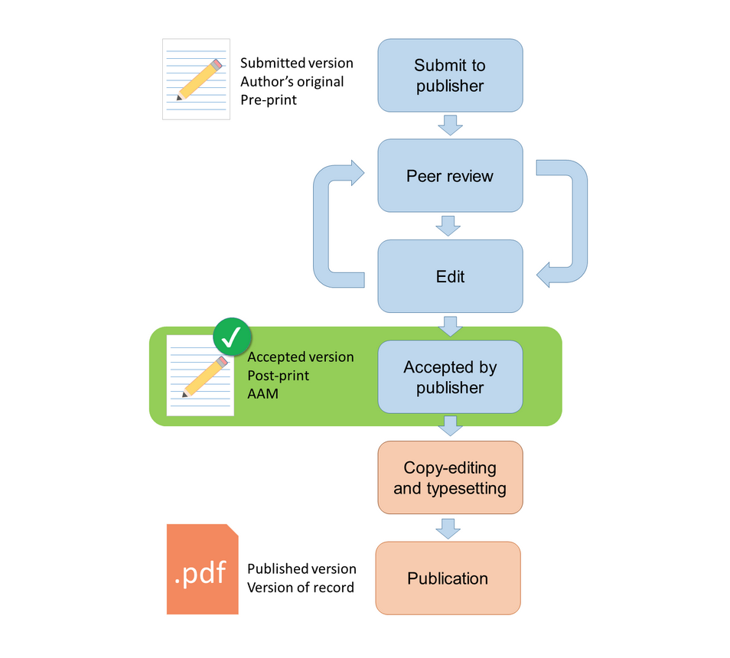
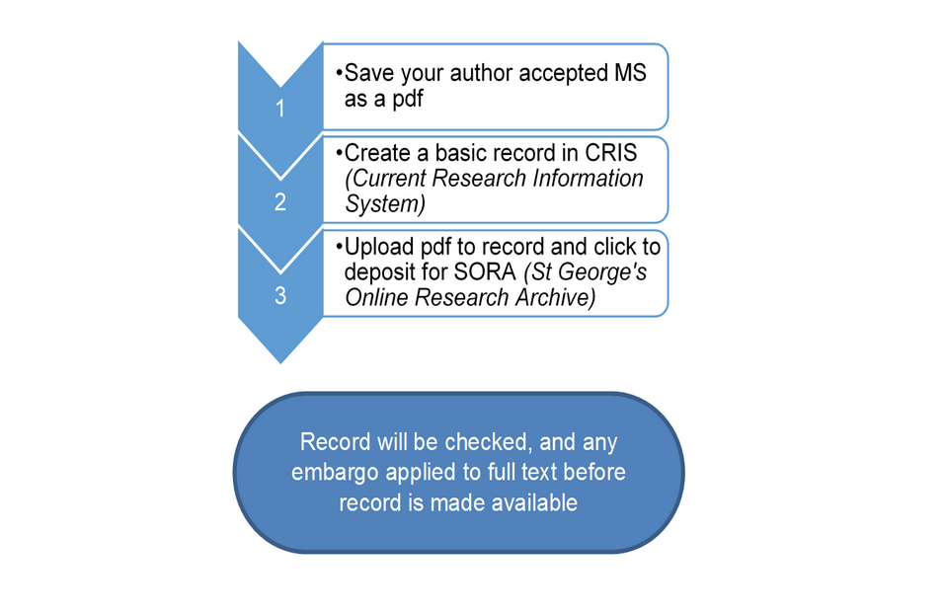
Open Access at St George’s - https://cris.sgul.ac.uk/
SGUL’s Research Publications Policy requires that the upload is made via the CRIS for our institutional repository, SORA.
Don’t wait for CRIS to notify you that a paper has been detected. As soon as your paper is accepted, deposit it!
https://www.sgul.ac.uk/about/our-professional-services/information-services/library/researchers/cris-and-sora

Slide 20
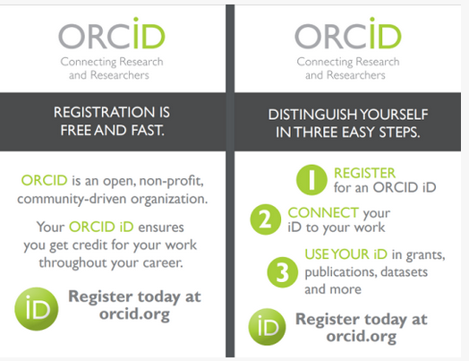
ORCID - https://orcid.org/
REF2021 “strongly encourage” all submitted staff to have an ORCID account
Any REF2021 submitted papers need to be in your ORCID accounts
In ORCID, your account needs to be visible to everyone (top right)
Please deposit your ORCID account number into the CRIS

Slide 21
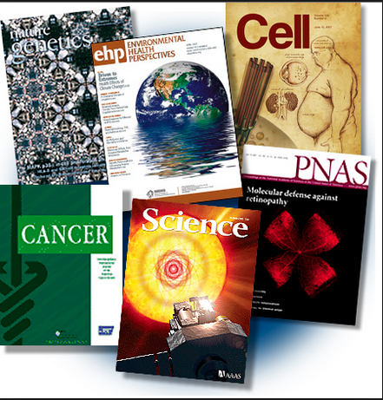
What if there are multiple REF eligible SGUL authors on the paper?
Strategies for teams and collaborators -
Each paper can only be submitted once, even if there are multiple SGUL authors
Identify your REF eligible colleagues at SGUL
Each staff member must submit at least 1 and a maximum of 5 papers (6 to the mock)
Ensure everyone has at least one 3* paper to return
Ensure no 4* or strong 3* papers are excluded from return because one colleague
has >5 papers
Remember :
lead or corresponding authorship can be shared
don’t forget statements on your contribution to
the manuscript

Slide 22

Assessment - What is a 3* or 4* quality paper?
Important because 3* papers and 4* papers bring income, while those assessed as 2* or less do not.
4* papers are weighted at 4 times the value of a 3* paper for REF2014
- Guidance from REF2021
- Guidance from panel members
- Metrics
Journal impact factors are not used
Citations are used
Note: Assessment is subjective.
Assessment panels undertake multiple calibration excercises

Slide 23
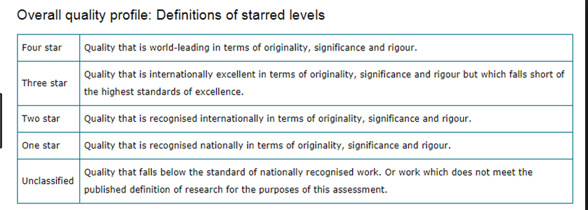
Assessment – Outputs

Slide 24
Outputs - REF2021 Panel A specific guidance
The sub-panels will look for evidence of the quality of the output in terms of its originality, significance and rigour
Originality – the extent to which the output makes an important and innovative contribution to understanding and knowledge in the field
Significance – the extent to which the work has influenced or has the capacity to influence, knowledge and scholarly thought, or the development and understanding of policy and/or practice
Rigour – the extent to which the work demonstrates intellectual coherence and integrity, and adopts robust and appropriate concepts, analyses, sources, theories and/or methodologies

Slide 25
The panel will look for evidence of
  scientific rigour and excellence, with regard to design, method, execution and analysis
  significant addition to knowledge and to the conceptual framework of the field
  potential and actual significance of the research
  the scale, challenge and logistical difficulty posed by the research
  the logical coherence of argument
  contribution to theory-building
  significance of work to advance knowledge, skills, understanding and scholarship in theory, practice, education, management and/or policy
  applicability and significance to the relevant service users and research users
  potential applicability for policy in, for example health, healthcare, public health, animal health or welfare.

Slide 26
Guidance from previous panel members
Prof Neil Gow, Aberdeen (new DVC (R&I) Exeter)
UoA5 REF2014 and Criteria panel REF2021
A guide to REF star ratings in preparation for REF 2021
In preparing our papers for REF 2021, and assessing those already published, a guide to the REF 'star rating' system should be useful. In REF2021 it is almost certain that only 3* and 4* papers will be of value in a submission.
Although there will be exceptions to any set of descriptors, the following guide sets out the expected qualities of a 2*, 3* and 4* paper, in the context of the clear message that a paper's star rating is not governed by its journal impact factor. With the help of colleagues with extensive experience of the operation of a REF panel, we have therefore put together the following descriptors (which will evolve as guidance is issued by the REF organisation) to help as you assess papers you have already published, and which supplement the minimal (bolded) descriptions given in the official REF guidance. More importantly, we hope they will be informative as you begin to strategically plan the new papers your lab will produce over the next 4-5 years.

Slide 27
4*; Quality that is world-leading in terms of originality, significance and rigour.
This will be a paper that may be paradigm-shifting, or one with major impact within and outside of its field of study. It is likely to be ‘first in its field’ rather than ‘first in organism’ or ‘first in niche area’. It will stake a claim to a new area of science rather than make a niche-specific claim. It will have some or all of the following characteristics;
Be EITHER strongly hypothesis-driven research defining and analysing a causal link between two or more effects OR a descriptive study with a breadth of scope and reach producing impact of major significance.
Use multiple front line, modern experimental approaches that frequently draw on methodologies from a range of different subjects, for example a study fundamentally based in molecular biology may be augmented with structural biology or systems biology analyses. It will frequently describe an interdisciplinary or multidisciplinary investigation.
Frequently involve the development and validation of completely new methodologies, or enhance and optimise, or re-purpose existing methodologies; these technologies allow hitherto remote knowledge and understanding to be accessed.
The data will invariably be comprehensive, or will involve significant appended supplementary information to evidence the depth and rigour of the study.
It will reach conclusions that have been tested across a range of model systems or using multiple complementary approaches, and which arrive at broad-ranging conclusions relevant to multiple research communities.
It will be a study with strong, clear, conclusions, emphasising the positive assertions that can be made as a result of the study. It will have the significance that has the potential to be textbook-changing in time.
The interest and importance of the paper will be complemented by excellent, concise and clear writing in a style that is accessible to non-specialists.
It will have a simplicity of overall message facilitated by the fundamental nature of the discovery, and a clear and compelling scientific story, written for a broad scientific readership.

Slide 28
3*; Quality that is internationally excellent in terms of originality, significance and rigour but which falls short of the highest standards of excellence.
Papers of 3* quality represent a very high quality descriptive analysis of a system, its correlations or its behaviour, containing some element of phenomenology. They describe research of high quality within a field, with significant but focused impact within a more restricted area of research. They will have some or all of the following characteristics;
Be EITHER hypothesis-driven research defining and analysing a causal link between two or more effects OR a descriptive study with significant impact across the breadth of a field, but restricted to that field.
Use limited numbers of functional tests of a hypothesis. The dataset will fully support the principal conclusions but may not be extremely comprehensive in nature.
Employ a range, possibly a broad range, of strong but standard experimental tools and methodologies, sometimes, but not invariably restricted to a single discipline e.g. molecular biology.
The study conclusions will be rigorous and definitive, but often be limited to a single system or organism.
The study conclusion will be unequivocal, and will not be undermined by obvious weaknesses or gaps in the study. It may however communicate a narrowly-focused inference or deduction.
The research investigation will be high quality, but with a restricted focus, written for the experts in that particular field. Its novelty will be significant but not paradigm changing. It may have some appeal for experts in connected fields.

Slide 29
2*; Quality that is recognised internationally in terms of originality, significance and rigour.
This will be a paper representing a high quality descriptive analysis of a system, its correlations or its behaviour, perhaps containing a significant element of phenomenology. While the research is nevertheless of high quality, it will describe a scientific investigation with a notably restricted focus, with low to moderate impact in its field. It will have some or all of the following characteristics;
A descriptive analysis of a system, its correlations and phenomenology. Investigations of an underlying hypothesis may not reach unequivocal conclusions as to causation, limiting the impact.
Possibly employing a restricted range of methodologies, sometimes even based on single methods.
The dataset will be sufficient to support the principal conclusions but may not comprehensive in nature, and will rarely included supplementary supporting information.
Conclusions of the paper usually limited to a single system or organism.
The underpinning conclusions may be novel and rigorous, but may be descriptive, communicating a (single) restricted observation or deduction; frequently descriptive of a phenomenon rather than identifying completely novel underlying causation; an extension of an established principle in the field.
A research investigation with a significantly restricted and narrow focus, written for the experts in that particular field; with limited appeal to researchers in other fields.

Slide 30
REF Star rating summary
The following table summarises some of the key points. It is important to recognise that not all papers in any given star category will meet all the listed criteria. A paper might for example be hypothesis driven, or instead have a breadth of coverage of a particular research question that renders its impact high. Similarly a paper might be interdisciplinary, use multiple novel methods, but reach conclusions of limited impact, rendering it 2*. This summary should therefore be interpreted thoughtfully.
Criterion | 2* | 3* | 4*
Title wording | Descriptive | Informing | Asserting and concluding; clear encapsulation of a profound discovery
Scope and definition of title | Narrow, species-specific | Broader, wider implications, refining understanding or incrementally broadening a field | Broad panacea, ubiquitously or very broadly relevant, re-defining understanding in a subject area
Study ambition | Modest | Significant | Exceptional, with the goal of being revolutionary
Timeliness and novelty | Contemporary, incrementally advancing a field but not ahead of the curve | Contemporary, adding new information to an actively advancing research field | Extremely contemporary, breaking ground for the first time in any field
Methods used (typically, but not exclusively) | Single, restricted corroboration | Multiple, staged corroboration, often interdisciplinary | Cross-disciplinary, field-leading methodologies, with multiple corroboration, very commonly interdisciplinary
Where relevant; model systems employed | Often: single | Sometimes single, but usually multiple | Almost invariably multiple
EITHER Hypothesis-driven OR breadth leading to impact | Hypothesis: Arguably/possibly Breadth and depth: very limited | Hypothesis: simple, derivative Breadth and depth: moderate, leading to moderate impact | Hypothesis: Dogma-challenging Breadth and depth: high, leading to significance of impact.
Where relevant; causation or mechanism establishment | Possibly | Probably | Undoubtedly
Conclusions reached | Restricted in scope and impact | Clear, field-influencing | Clear, broad influence; potential to be text-book changing or influencing policy, management of strategy

Slide 31
Metrics / Indicators
“Panel A will use citation information, where appropriate and available, as a potential indicator of academic significance…”
REF2021 provides contextual citation data for all outputs to UoA panel members.
It has been commissioned from Symplectic (Web of Science) and includes the mean, top 1%, 5%, 10%, 25% and 50% citations per paper for each year of publication and for each research field.
Journal impact factors (JIF) will not be provided. Panel members are instructed to only use metrics provided.
Research England have signed up to DORA and discourage the use of JIF in particular.
(Separate talk on DORA and Using Publication metrics responsibly is available.)

Slide 32
Contextual citation data
https://www.ref.ac.uk/guidance/citation-and-contextual-data-guidance/
Example of contextual citation data provided (Feb 2020)
 | 2013 |  |  |  |  |  |  | 2014
Journal Subject Category | 1% | 5% | 10% | 25% | 50% | Number of documents | Mean | 1% | 5% | 10% | 25% | 50% | Number of documents | Mean
IMMUNOLOGY | 178 | 75 | 49 | 25 | 13 | 21553 | 23.49 | 149 | 63 | 42 | 22 | 11 | 22010 | 19.76
INFECTIOUS DISEASES | 124 | 57 | 39 | 22 | 11 | 14358 | 18.64 | 117 | 50 | 34 | 19 | 10 | 15409 | 16.48
MICROBIOLOGY | 143 | 67 | 46 | 26 | 13 | 21516 | 21.73 | 120 | 57 | 40 | 22 | 11 | 22011 | 18.49
For example, an ID paper published in 2014 with 25 WoS citations in Feb 2020 would be
in the top 25% of cited papers
Articles published in 2019 do not currently have citation data available
Articles published in 2020 will not be compared to citation data for REF2021.
You can find the citation scores for your own papers in CRIS (WoS)
or in the Web of Science website https://wok.mimas.ac.uk/
(do not use Google Scholar!!)

Slide 33
How to increase your citations
Promote your papers by
Oral and poster presentations at conferences
Discussions with colleagues
Social media
Twitter
Facebook
LinkedIn
ResearchGate
…
Public engagement
- SELF cite!

Slide 34
Output Summary & Mock REF
Assessing outputs is subjective, and even contentious.
The guidance provided should help identify quality
Metrics can be useful, and citation counts in context are used by the panels
In the mock REF we are asking you to tell us about your top papers, their eligibility,
their citations, originality, significance and rigour
This information will be used to shortlist the papers we will submit. Shortlisted papers will be reviewed internally in March to June 2020.
We will then choose your top paper to submit. Next we will identify the next best papers (maximum of 5 per staff member) until we reach FTE x 2.5 papers.
In October, we will ask you again if you have any new papers published in 2020 we should consider (let us know now if you are expecting strong papers).

Slide 35

Impact Cases
St George’s will submit 9 impact cases, 7 for UoA1 and 2 for UoA2.
These cases have been identified, shortlisted and are being developed.
Underpinning research must be published between Jan 2000 and Dec 2020.
Impact occurred between 1 Aug 2013 and 31 July 2020.
Definition of impact for the REF:
Impact is defined as an effect on, change or benefit to the economy, society, culture, public policy or service, health, the environment or quality of life, beyond academia.
It excludes impacts on research or the advancement of academic knowledge within the HEIs (whether in the UK or international).
Impact does not include grants awarded, sitting on committees, papers published...

Slide 36
Five page submission covering :
Summary (100 words)
underpinning research (500 words)
References (max. 6)
details of the impact (750 words)
sources to corroborate the impact (max 10).
It is important that all the evidence of impact is captured (e.g. published quantitative data, testimonial, web-pages, guidelines).
Impact Cases Assessment –
Reach – the extent and/or diversity of the beneficiaries of the impact
Significance - the degree to which the impact has enabled, enriched, influenced
informed or changed the performance, policies, practices, products, services,
understanding, awareness or wellbeing of the beneficiaries.

Slide 37
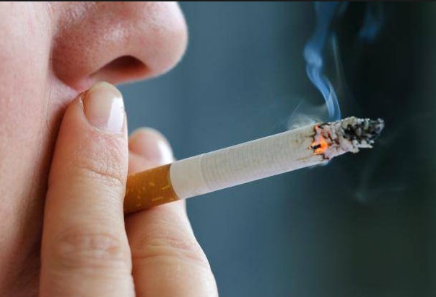
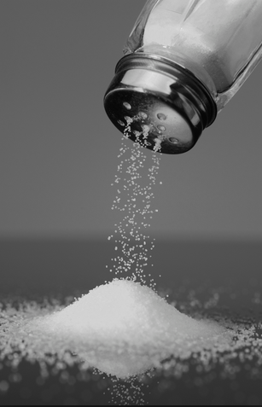
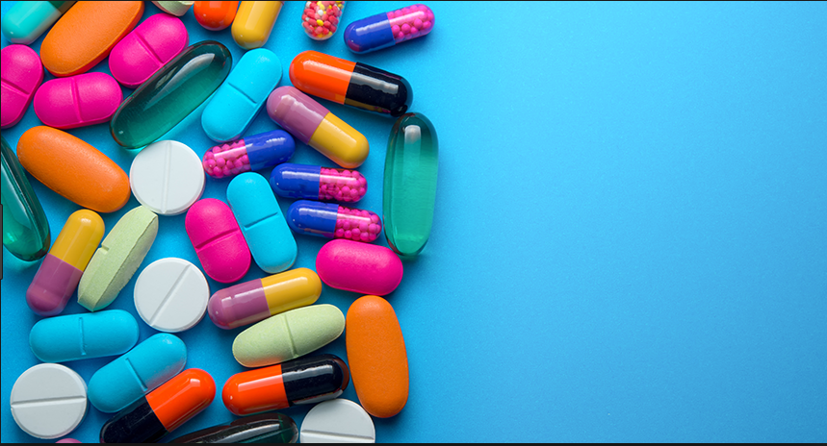
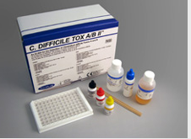
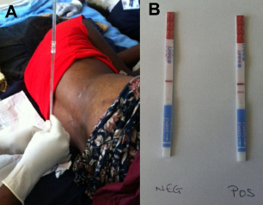
Want to know more?
All impact cases submitted in REF2014 are published
http://impact.ref.ac.uk/CaseStudies
SGUL REF2014 impact cases
Development of dual targeting antibacterials and the circumvention of resistance
Discovery and development of thalidomide analogues for treatment of myeloma and other cancers
Effects of outdoor air pollutants on human health
Effects of parental smoking on respiratory health among children
Improved diagnosis of Clostridium difficile infection through two stage testing
Optimising the prevention and management of HIV associated cryptococcal meningitis
Reducing salt intake to reduce risk of heart attack and stroke

Slide 38

Environment –
Two parts - SGUL overview (not assessed)
- one for each UoA. Length dependent on FTE
(UoA1 12800 words, UoA2 8000 words)
- lead writers are Institute Directors
Assessment criteria –
Vitality – the extent to which a unit supports a thriving and inclusive research culture for all staff and research students, that is based on a clearly articulated strategy for research and enabling its impact, is engaged with national and international research and user communities and is able to attract excellent postgraduate and postdoctoral researchers
Sustainability - the extent to which the research environment ensures the future health, diversity, wellbeing and wider contribution of the unit and the disciplines, including investment in people and infrastructure
https://www.ref.ac.uk/publications/panel-criteria-and-working-methods-201902/

Slide 39
For each UoA:
Unit context, research and impact strategy
eg. Structure, research objectives, enabling impact, interdisciplinary research, open access and open data, data sharing, research integrity
2. People, including:
  Staffing strategy and staff development
  eg. ECRs, PGRs, mentoring, PRs, HREIRA, recruitment, succession planning, leave, exchange with industry, recognition and reward.
  Research students
  eg. Quality of training and supervision, culture, recruitment, funding, monitoring and support, completions, skill development
  Equality and diversity
  eg. Recruitment and support, strategies, activities and collaborations, study leave, flexible working, part-time, conference, funding, promotion, support, wellbeing, integration of clinical academics
Income, infrastructure and facilities
- funding and funding strategies, organizational infrastructure for impact, specialist facilities, collaboration.
Collaboration and contribution to the research base, economy and society

Slide 40
Collaboration and contribution to the research base, economy and society
  Support for effective collaborations locally, nationally or internationally
  Evidence of engagement with research beneficiaries to enrich research
  Impact of research to economy & society,
  Engagement with diverse communities through research
  Contribution to sustainability of the discipline, response to priorities and initiatives
  Indicators of wider influence, such as journal editorship, grants committees, prizes, Research Council or similar committees, invited keynotes or chairs, refereeing, PGR training recognition
  Category C staff (Trust) contribution to research
  Supporting reproduceable research data
  Collaboration or integration with external organizations
Please deposit key information in your new SGUL webpage
(or discuss or send to your Institute Director)

Slide 41
Some of the cross-Institute ongoing initiatives at SGUL contributing to REF2021 Environment :
Open Access
Research Data Management (RDM)
Research Integrity/Ethics
Athena Swan
Equality and Diversity Committee
Clinical Academic Groups (CAGs)
Joint Clinical Research Committee
HR Excellence in Research Award (HRERA)
Staff Development
Early Career Research Development
St George’s Academic Training (GAT)
DORA and using Publication Metrics Responsibly
Graduate School outcomes (PhD students)
Enterprise & Innovation
Estates and Facilities
…

Slide 42
I’m a REF eligible academic, what do I need to do?
Complete the mock REF
ORCID account : visible to everyone and up-to-date, enter the number into CRIS
  If you have an impact case, you are already working with us
  If you have an impact case for next time, and need advice, please read the guidance and/or ask.
  Environment
  Add your contributions to your webpage or make sure your ID knows about them
  Support our Environment, and projects involved, e.g.
  - Income
  - PhD submission rates
  - Deposition of all papers (CRIS) and data (Public/SGUL Research Data Repository)
  - Equality and diversity
  - Staff development
  - Interdisciplinary research
  - Collaboration with organisations beyond higher education

Slide 43
St George’s REF2021 submission is due 27 November 2020.
Results will be published December 2021.
Questions?
Jodi Lindsay – jlindsay@sgul.ac.uk
Academic Lead for REF
Yvonne Castle – ycastle@sgul.ac.uk
Research Strategy and Development Manager, JRES
SGUL REF Executive committee
Alicja Rudnicka
Dorothy Bennett
Dan Forton
Jenny Winters
Jon Friedland
Juan Carlos Kaski
Julian Ma
Laura Southgate
Louise Phillips
Mark Cranmer
Peter Garrard
Peter Whincup
Rachel Allen
Tom Harrison
Vanessa Ho

Slide 44
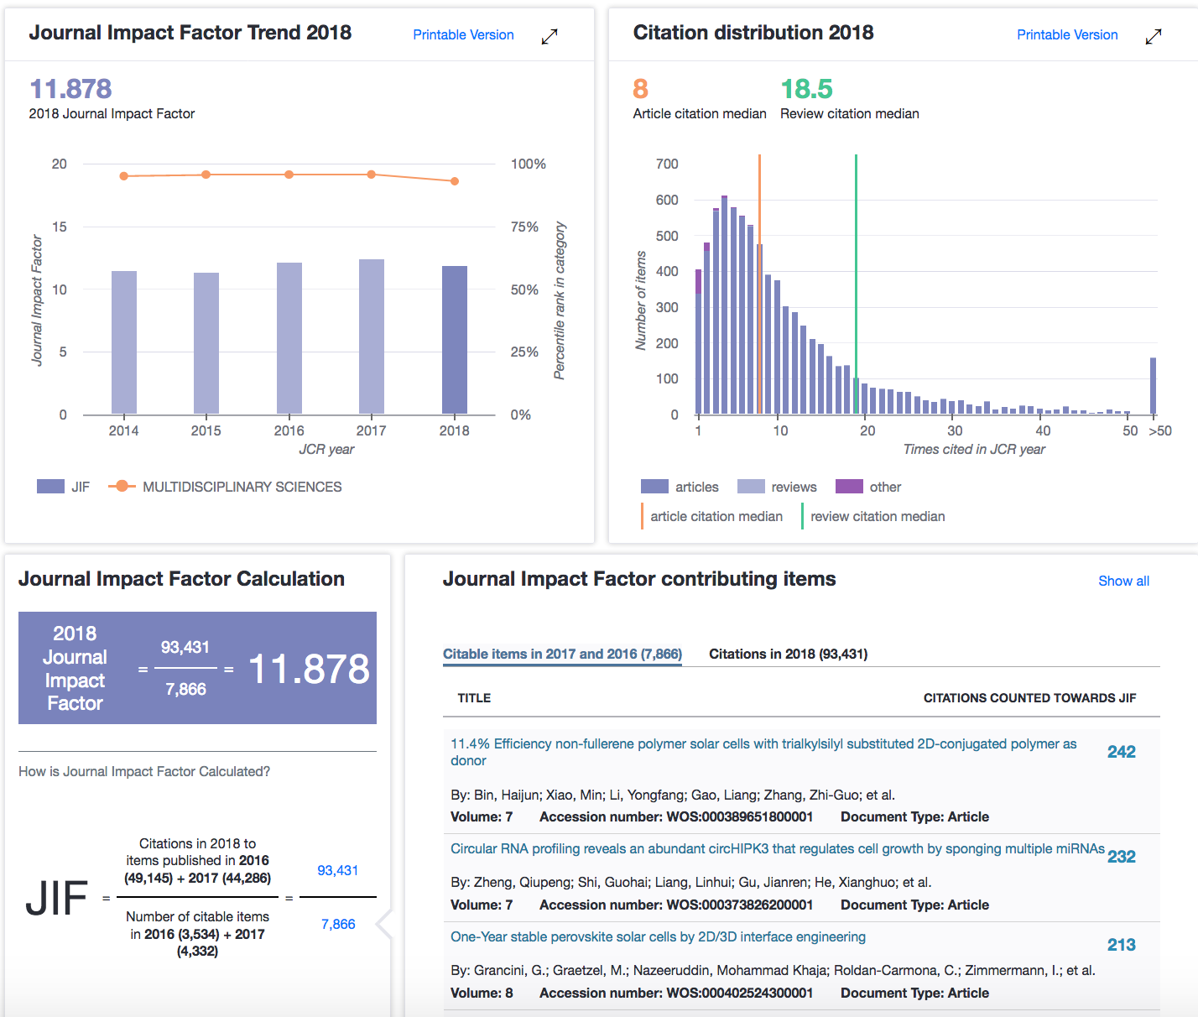
Journal Impact Factors
Are published by Web of Science
(subscription to Clarivate)
Open and transparent ?
Improved since 2018
Now much more verifiable
evidence for scores.
Example here is Nature Comms
Citation distributions are skewed, especially by outliers
Mean vs median, articles vs reviews vs other…
Full dataset available

Slide 45
Issues with JIF –
The ‘quality’ of the the journal is not the ‘quality’ of any individual paper published in that journal.
Articles in journals with high JIF can have low citation counts (eg. Nature Comms example, >140 papers cited zero times)
Researchers waste a lot of time and energy trying to publish in journals with the highest JIF
Editorial boards – can be cliquey or powerful
Biases – very field dependent – smaller fields have smaller JIFs
Journal publishers can ‘game’ JIF – e.g. delay the publication date of papers, publish small numbers of selected papers
and/or use ‘cascade journals’, etc. Publishers charge APC and subscription fees.
Result - REF2021 says – JIF should not to be used to assess quality of papers
DORA and Leiden manifestos – strongly recommend that we do not rely on JIF to assess quality of papers
Questions for you - Why do we need journal metrics?
- Do we judge a paper differently because of the journal it is published in, and why?
- What are the dangers around choosing to publish in a journal because of its JIF?

