Slide 1


Thank you for agreeing to be an internal reviewer of Outputs
for SGUL’s REF2021 submission
Today –
- What are we asking you to do?
- Authorship rules
- What is a 3* or 4* paper?
- How should I use metrics in my assessment?
- Deadlines and next steps
- Any questions?
Aug 22, 2020
Jodi Lindsay
The slides will be available by email after the presentation

Slide 2

You have been invited to help us assess the quality of selected SGUL Outputs in your field of research
You’ve been sent between 2 - 28 papers in an Excel file
We do not expect you to spend more than 30 mins per paper
Your list does not usually include the top papers that SGUL will submit, but those that are
  3* and we need to make a decision between 3* papers
  To identify the top paper for an individual
  Papers from staff who have left or did not take part in the mock REF
  Where there is a query about authorship

Slide 3
Excel file provided to you by Yvonne Castle Aug 14.
the title and doi or SORA link for the paper. Please click or use a google search to access the paper. If you have any problems accessing the paper, please contact sora@sgul.ac.uk.
the name of the author that we will likely attach to the paper (although it is still possible we will submit under another author’s name). The name should help you identify eligibility of the author and the paper.
The WoS citation score in Feb 2020. This is for comparison with the citation tables/contextual data provided by REF2021, and to assist with identifying if the paper is in the top cited 1%, 5%, 10%, 25%, or 50% in its field for the year of publication.
Please fill out –
Is the paper and author eligible for submission. Yes, not sure, no.
Score the paper based on REF2021 assessment criteria to one decimal place, between 1.0 – 4.0.
Comments, optional. Please let us know if you have any concerns, questions, caveats etc. about your responses.

Slide 4
Is the paper assigned to this author eligible for submission?
At this stage we are specifically focused on author contribution.
If there are 16 or more authors, and the nominated author is not the lead or corresponding author, does it clearly state in the manuscript both –
a.
The author made a substantial contribution either to the conception and design of the study; or to the organisation of the conduct of the study; or to carrying out the study; or to analysis and interpretation of study data.
And
b.
The author helped draft the output; or critique the output for important
intellectual content.
This contribution should be clearly stated in the manuscript. If it is not, please flag your concerns to us.
Separately, we are writing to authors of these papers asking the corresponding author to confirm their contribution in a letter. However, if the paper does not actually say this or leaves doubt, this may override the letter.

Slide 5

Quality - What is a 3* or 4* paper?
Important because 3* papers and 4* papers currently bring income, while those assessed as 2* or less do not.
4* papers are weighted as 4 times the value of a 3* paper.
- Guidance from REF2021
- Guidance on metrics from REF2021
- Guidance from panel members
Note: when the REF assessment panels first meet they
spend a lot of time ‘normalizing’ opinions.
Assessment is subjective.

Slide 6
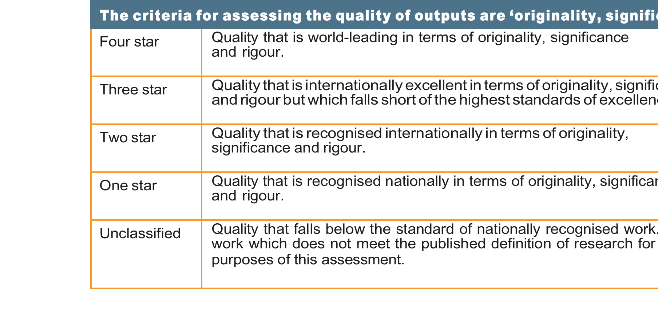
Assessment – Outputs Scoring
Source - https://www.ref.ac.uk/publications/guidance-on-submissions-201901/ Annex A
Please decide if the paper has reached a star threshold and then provide your
scores to one decimal place, e.g. 3.5.
4* paper score as 4.0
3* paper range is 3.0 to 3.9 (special area of focus)
2* paper range is 2.0 to 2.9
1* paper range is 1.0 to 1.9

Slide 7
Assessment criteria
Originality will be understood as the extent to which the output makes an important and innovative contribution to understanding and knowledge in the field. Research outputs that demonstrate originality may do one or more of the following: produce and interpret new empirical findings or new material; engage with new and/or complex problems; develop innovative research methods, methodologies and analytical techniques; show imaginative and creative scope; provide new arguments and/or new forms of expression, formal innovations, interpretations and/or insights; collect and engage with novel types of data; and/or advance theory or the analysis of doctrine, policy or practice, and new forms of expression.
Significance will be understood as the extent to which the work has influenced, or has the capacity to influence, knowledge and scholarly thought, or the development and understanding of policy and/or practice.
Rigour will be understood as the extent to which the work demonstrates intellectual coherence and integrity, and adopts robust and appropriate concepts, analyses, sources, theories and/or methodologies.

Slide 8
Panel A specific guidance
In assessing outputs, the sub-panels will look for evidence of the quality of the output in terms of its originality, significance and rigour
  scientific rigour and excellence, with regard to design, method, execution and analysis
  significant addition to knowledge and to the conceptual framework of the field
  potential and actual significance of the research
  the scale, challenge and logistical difficulty posed by the research
  the logical coherence of argument
  contribution to theory-building
  significance of work to advance knowledge, skills, understanding and scholarship in theory, practice, education, management and/or policy
  applicability and significance to the relevant service users and research users
  potential applicability for policy in, for example health, healthcare, public health, animal health or welfare.

Slide 9

Metrics (citation scores and JIF)
‘The sub-panels will use citation information… as part of the indication of academic significance to inform their assessment of output quality.’
Source - https://www.ref.ac.uk/publications/panel-criteria-and-working-methods-201902/ Paragraphs 190 – 201.
Citation data - https://www.ref.ac.uk/guidance/citation-and-contextual-data-guidance/ links to the excel file Contextual Data February 2020 and the scores used to calculate the top citation percentages in each field by year (separate tables for reviews). This data has been commissioned by REF2021 from Web of Science.
The contextual data provided does not include papers published in 2019 yet, and all the data is due to be updated in September 2020.

Slide 10
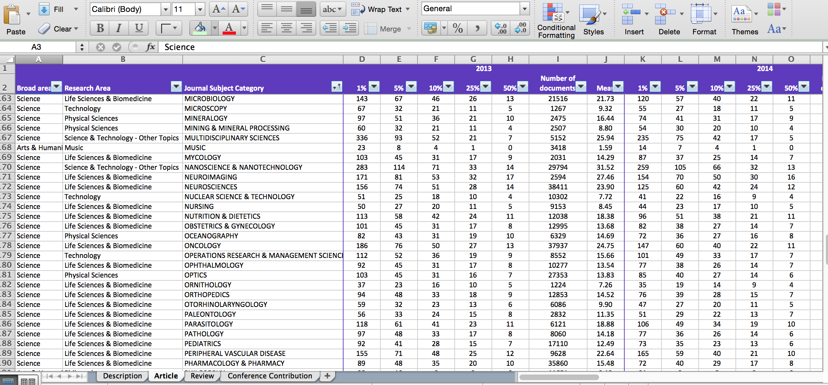
Example of contextual citation data from REF2021

Slide 11

Metrics - What about Journal Impact Factors?
REF2021 are very clear that they believe JIF are not an indicator of the quality of individual papers.
This conclusion was reached after an extensive commissioned analysis and review :
The Metric Tide: Independent Review of the role of metrics in Research
Assessment and Management’
Including a supplementary report ‘Correlation analysis of REF2014 scores
and metrics’ www.dcscience.net/2015_metrictideS2.pdf
SGUL and Research England are signatories to DORA, and the use of JIF is therefore discouraged as a measure of output quality.
Furthermore, REF2021 repeatedly instruct assessment panel members not to use JIF.
Instead, REF2021 commissioned Web of Science to provide the citation tables as an alternative. They also emphasise that each paper is read by panel members and assessed for Originality, Significance and Rigour.

Slide 12
A note on Review papers –
SGUL will not be submitting review articles, but may submit systematic reviews, preferably registered in Prospero.
Systematic reviews will be judged by the criteria of originality, significance and rigour.
Citation scores are compared to other reviews.

Slide 13
Help! I still need more guidance!
Additional guidance from a previous panel member (not official REF2021 guidance)
Prof Neil Gow, Aberdeen (new DVC (R&I) Exeter)
UoA5 REF2014 and Criteria panel REF2021
A guide to REF star ratings in preparation for REF 2021
In preparing our papers for REF 2021, and assessing those already published, a guide to the REF 'star rating' system should be useful. In REF2021 it is almost certain that only 3* and 4* papers will be of value in a submission.
Although there will be exceptions to any set of descriptors, the following guide sets out the expected qualities of a 2*, 3* and 4* paper, in the context of the clear message that a paper's star rating is not governed by its journal impact factor. With the help of colleagues with extensive experience of the operation of a REF panel, we have therefore put together the following descriptors (which will evolve as guidance is issued by the REF organisation) to help as you assess papers you have already published, and which supplement the minimal (bolded) descriptions given in the official REF guidance. More importantly, we hope they will be informative as you begin to strategically plan the new papers your lab will produce over the next 4-5 years.

Slide 14
4*; Quality that is world-leading in terms of originality, significance and rigour.
This will be a paper that may be paradigm-shifting, or one with major impact within and outside of its field of study. It is likely to be ‘first in its field’ rather than ‘first in organism’ or ‘first in niche area’. It will stake a claim to a new area of science rather than make a niche-specific claim. It will have some or all of the following characteristics;
Be EITHER strongly hypothesis-driven research defining and analysing a causal link between two or more effects OR a descriptive study with a breadth of scope and reach producing impact of major significance.
Use multiple front line, modern experimental approaches that frequently draw on methodologies from a range of different subjects, for example a study fundamentally based in molecular biology may be augmented with structural biology or systems biology analyses. It will frequently describe an interdisciplinary or multidisciplinary investigation.
Frequently involve the development and validation of completely new methodologies, or enhance and optimise, or re-purpose existing methodologies; these technologies allow hitherto remote knowledge and understanding to be accessed.
The data will invariably be comprehensive, or will involve significant appended supplementary information to evidence the depth and rigour of the study.
It will reach conclusions that have been tested across a range of model systems or using multiple complementary approaches, and which arrive at broad-ranging conclusions relevant to multiple research communities.
It will be a study with strong, clear, conclusions, emphasising the positive assertions that can be made as a result of the study. It will have the significance that has the potential to be textbook-changing in time.
The interest and importance of the paper will be complemented by excellent, concise and clear writing in a style that is accessible to non-specialists.
It will have a simplicity of overall message facilitated by the fundamental nature of the discovery, and a clear and compelling scientific story, written for a broad scientific readership.

Slide 15
3*; Quality that is internationally excellent in terms of originality, significance and rigour but which falls short of the highest standards of excellence.
Papers of 3* quality represent a very high quality descriptive analysis of a system, its correlations or its behaviour, containing some element of phenomenology. They describe research of high quality within a field, with significant but focused impact within a more restricted area of research. They will have some or all of the following characteristics;
Be EITHER hypothesis-driven research defining and analysing a causal link between two or more effects OR a descriptive study with significant impact across the breadth of a field, but restricted to that field.
Use limited numbers of functional tests of a hypothesis. The dataset will fully support the principal conclusions but may not be extremely comprehensive in nature.
Employ a range, possibly a broad range, of strong but standard experimental tools and methodologies, sometimes, but not invariably restricted to a single discipline e.g. molecular biology.
The study conclusions will be rigorous and definitive, but often be limited to a single system or organism.
The study conclusion will be unequivocal, and will not be undermined by obvious weaknesses or gaps in the study. It may however communicate a narrowly-focused inference or deduction.
The research investigation will be high quality, but with a restricted focus, written for the experts in that particular field. Its novelty will be significant but not paradigm changing. It may have some appeal for experts in connected fields.

Slide 16
2*; Quality that is recognised internationally in terms of originality, significance and rigour.
This will be a paper representing a high quality descriptive analysis of a system, its correlations or its behaviour, perhaps containing a significant element of phenomenology. While the research is nevertheless of high quality, it will describe a scientific investigation with a notably restricted focus, with low to moderate impact in its field. It will have some or all of the following characteristics;
A descriptive analysis of a system, its correlations and phenomenology. Investigations of an underlying hypothesis may not reach unequivocal conclusions as to causation, limiting the impact.
Possibly employing a restricted range of methodologies, sometimes even based on single methods.
The dataset will be sufficient to support the principal conclusions but may not comprehensive in nature, and will rarely included supplementary supporting information.
Conclusions of the paper usually limited to a single system or organism.
The underpinning conclusions may be novel and rigorous, but may be descriptive, communicating a (single) restricted observation or deduction; frequently descriptive of a phenomenon rather than identifying completely novel underlying causation; an extension of an established principle in the field.
A research investigation with a significantly restricted and narrow focus, written for the experts in that particular field; with limited appeal to researchers in other fields.

Slide 17
REF Star rating summary
The following table summarises some of the key points. It is important to recognise that not all papers in any given star category will meet all the listed criteria. A paper might for example be hypothesis driven, or instead have a breadth of coverage of a particular research question that renders its impact high. Similarly a paper might be interdisciplinary, use multiple novel methods, but reach conclusions of limited impact, rendering it 2*. This summary should therefore be interpreted thoughtfully.
Criterion | 2* | 3* | 4*
Title wording | Descriptive | Informing | Asserting and concluding; clear encapsulation of a profound discovery
Scope and definition of title | Narrow, species-specific | Broader, wider implications, refining understanding or incrementally broadening a field | Broad panacea, ubiquitously or very broadly relevant, re-defining understanding in a subject area
Study ambition | Modest | Significant | Exceptional, with the goal of being revolutionary
Timeliness and novelty | Contemporary, incrementally advancing a field but not ahead of the curve | Contemporary, adding new information to an actively advancing research field | Extremely contemporary, breaking ground for the first time in any field
Methods used (typically, but not exclusively) | Single, restricted corroboration | Multiple, staged corroboration, often interdisciplinary | Cross-disciplinary, field-leading methodologies, with multiple corroboration, very commonly interdisciplinary
Where relevant; model systems employed | Often: single | Sometimes single, but usually multiple | Almost invariably multiple
EITHER Hypothesis-driven OR breadth leading to impact | Hypothesis: Arguably/possibly Breadth and depth: very limited | Hypothesis: simple, derivative Breadth and depth: moderate, leading to moderate impact | Hypothesis: Dogma-challenging Breadth and depth: high, leading to significance of impact.
Where relevant; causation or mechanism establishment | Possibly | Probably | Undoubtedly
Conclusions reached | Restricted in scope and impact | Clear, field-influencing | Clear, broad influence; potential to be text-book changing or influencing policy, management of strategy

Slide 18
Deadlines and Next Steps
Our internal review deadline is Sept 30 2020
Once we have your scores, a subpanel of the SGUL REF Executive Steering Committee
will meet and identify for each UoA –
The top eligible paper from each REF returnable staff member
A list of the other papers under consideration which will be ranked.
The top papers will be chosen until a cut-off total of FTE x 2.5 is reached, removing those papers where all eligible SGUL authors on the paper have five others ranked more highly
We will call for staff to identify additional high quality papers published between March and Dec 31 2020 in Nov 2020, and may review some of them.
Final decisions will be confirmed by REF Steering Executive and approved by the Research Committee.
The process was agreed in SGUL’s Code of Practice, available on SGUL’s webpage and which has been sent to you.
We are committed to a transparent, consistent, accountable and inclusive process for assessing Outputs.

Slide 19

St George’s REF2021 submission is due March 31 2021.
Results will be published April 2022.
Any Questions?
Jodi Lindsay – jlindsay@sgul.ac.uk
Academic Lead for REF
Yvonne Castle – ycastle@sgul.ac.uk
Research Strategy and Development Manager, JRES
SGUL REF Executive committee
Alicja Rudnicka
Dorothy Bennett
Dan Forton
Jenny Winters
Jon Friedland
Julian Ma
Laura Southgate
Thank you for your help with our submission!
Louise Phillips
Mark Cranmer
Peter Garrard
Peter Whincup
Rachel Allen
Tom Harrison
Vanessa Ho

