Slide 1
Procedures and Regulations
Training Workshop 2017
Aileen O’Brien

Slide 2
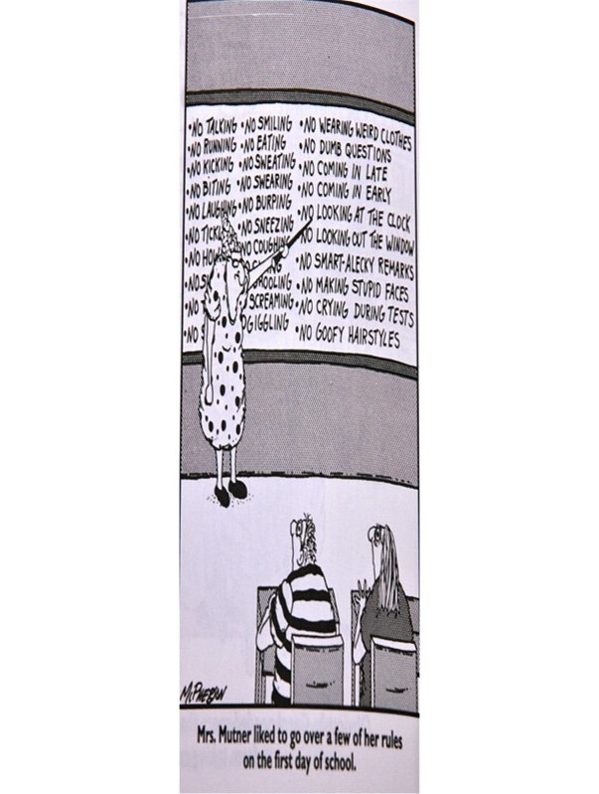

Slide 3
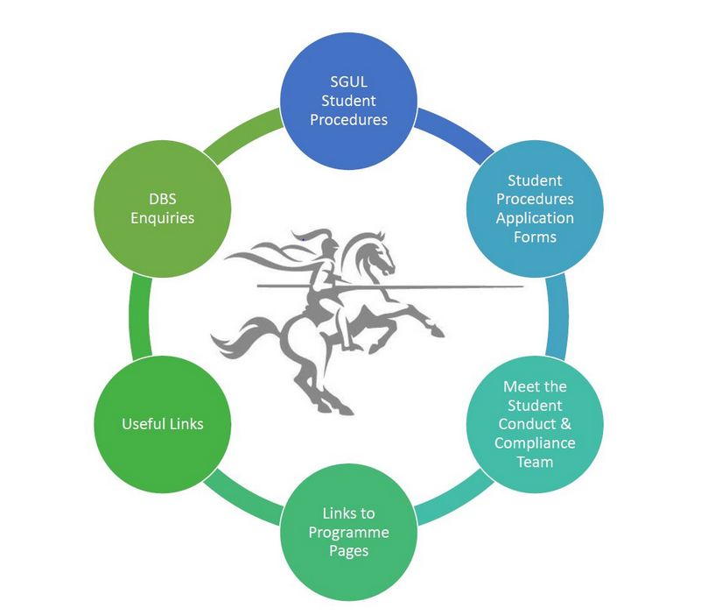
When do we need an
Investigating Officer?
https://portal.sgul.ac.uk/org/lis/reg/student-centre/student-affairs-and-compliance-pages/student-affairs-and-compliance

Slide 4
When do we need an
Investigating Officer?
Assessment Irregularity Procedure
Student Disciplinary Procedure
Procedure for Consideration of Fitness to Study or Practise
Student Concerns and Complaints Procedure

Slide 5





External Bodies
LAW
And Others……..

Slide 6

Policy Frameworks and Standards
QAA
OIA
GMC/HCPC/NMC guidance
UUK
Plagiarism tariff
Etc..

Slide 7
QAA’s Quality Code for HE Chapter B9
Higher education providers have procedures for handling academic appeals and student complaints about the quality of learning opportunities; these procedures are fair, accessible and timely, and enable enhancement.

Slide 8
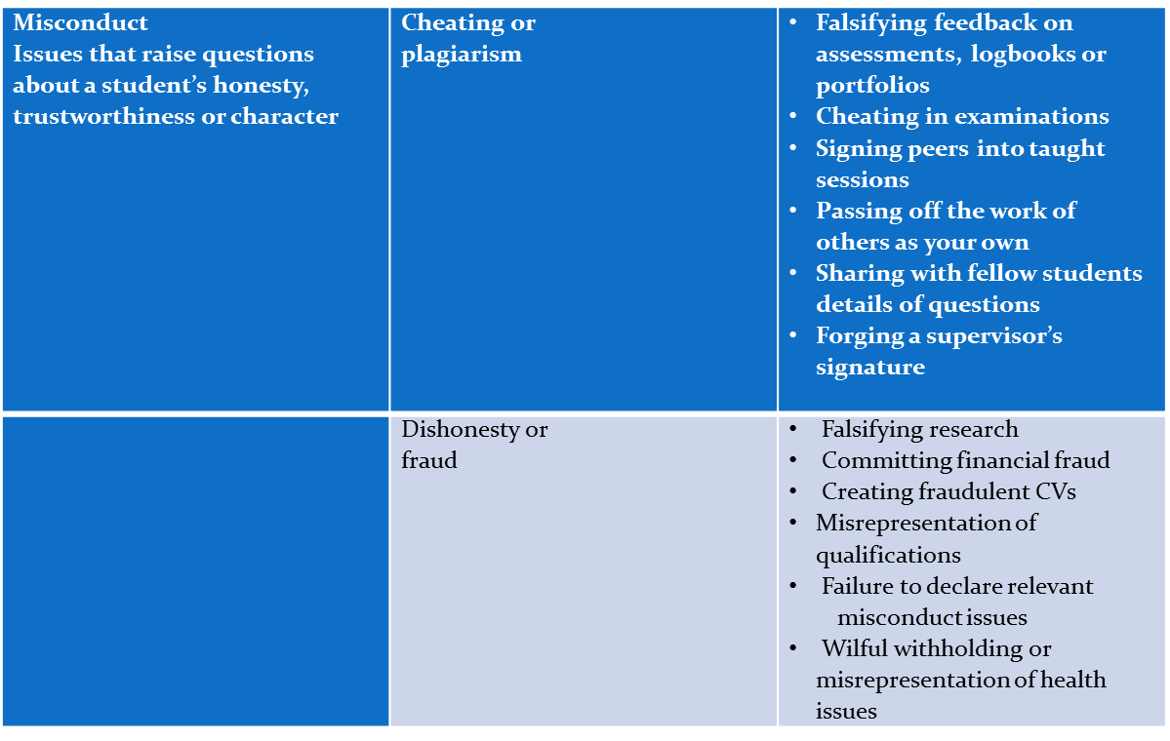


Slide 9
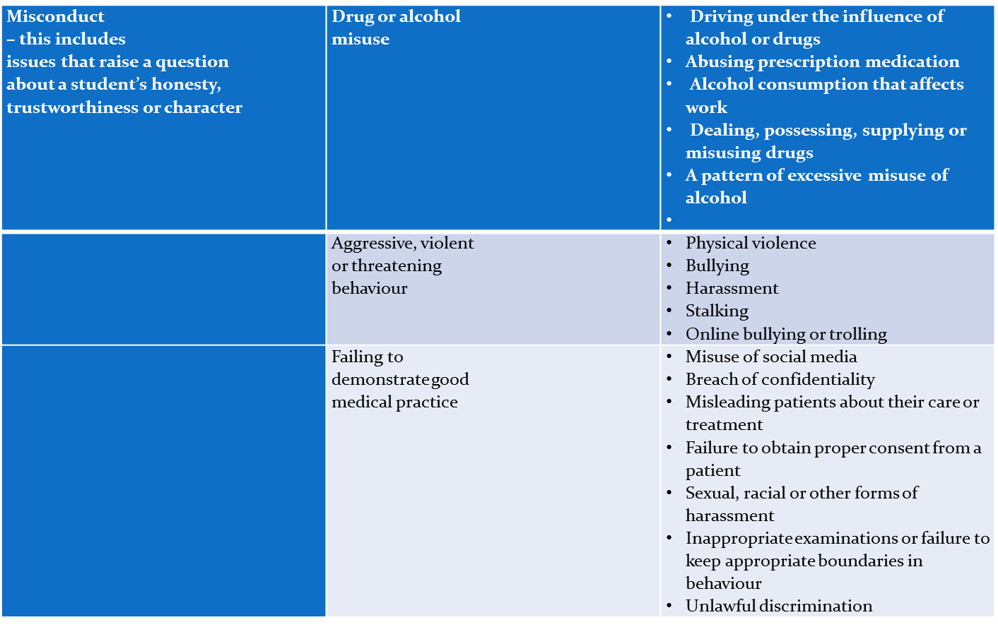

Slide 10
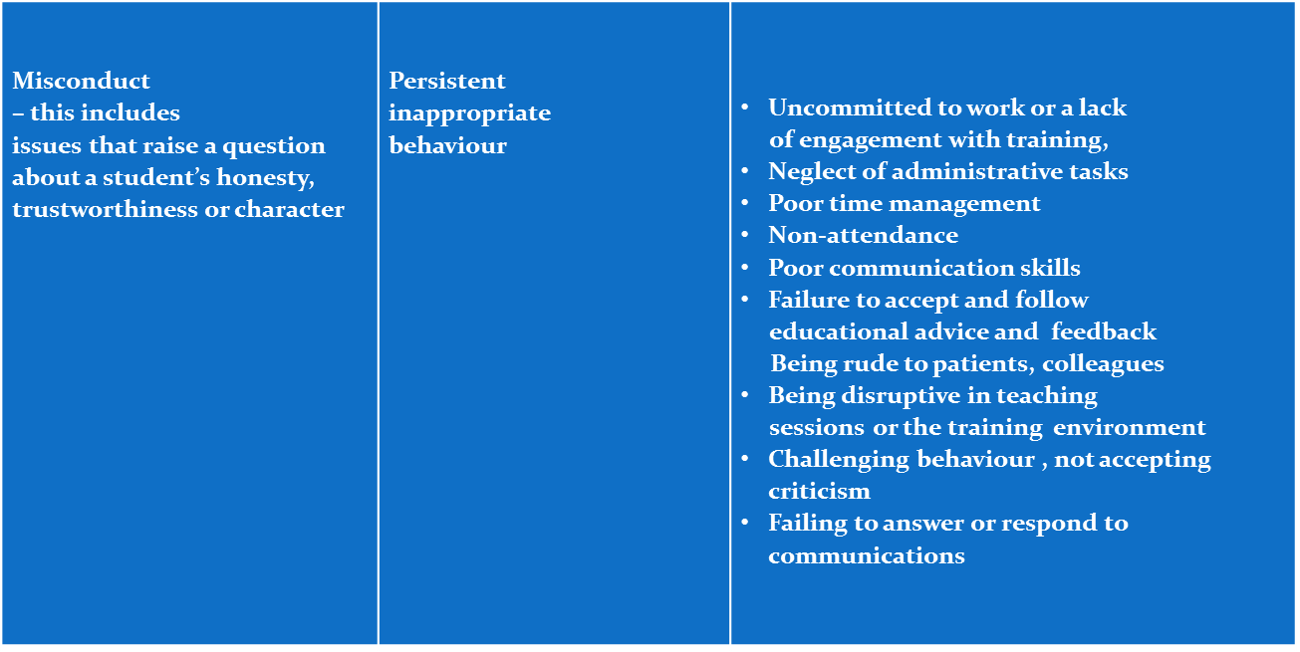

Slide 12
Health Concerns
Health problems do not preclude formal process being invoked
May lead to requirement for treatment rather than disciplinary penalty
University must provide ‘reasonable adjustment’ for disability
Occupational Health assesses health, advises about adjustments needed

Slide 13
Disability Officer arranges assessment dyslexia, mobility, other disability, and arranges appropriate support
Counselling Service offers confidential help
SGUL psychiatrist offers confidential assessment and treatment

Slide 14
