Slide 1

Unitu Report
Prepared for St George’s, University of London

Slide 2
Deployment Report
BOARDS | STUDENTS | REPS | STAFF | ADMINS
Allied Health and Nursing | 1,977 | 29 | 75 | 9
Medicine | 1,437 | 21 | 34 | 3
Post Graduate School | 450 | 10 | 34 | 5
UG Science | 871 | 14 | 31 | 4
>600
400-600
<400

Slide 3
Account Activation (Overall)
 | STUDENTS | REPS | STAFF
St Georges’ Overview | 43% | 74% | 90%
Avg across Uni’s | 44% | 71% | 82%
>60%
30%-60%
<30%
>90%
60%-90%
<60%
>70%
50%-70%
<50%

Slide 4
Account Activation (across each board)
BOARD | STUDENTS | REPS | STAFF
Allied Health and Nursing | 19% | 76% | 93%
Medicine | 76% | 86% | 91%
Post Graduate School | 14% | 40% | 79%
UG Science | 59% | 79% | 94%
>60%
30%-60%
<30%
>90%
60%-90%
<60%
>70%
50%-70%
<50%

Slide 5
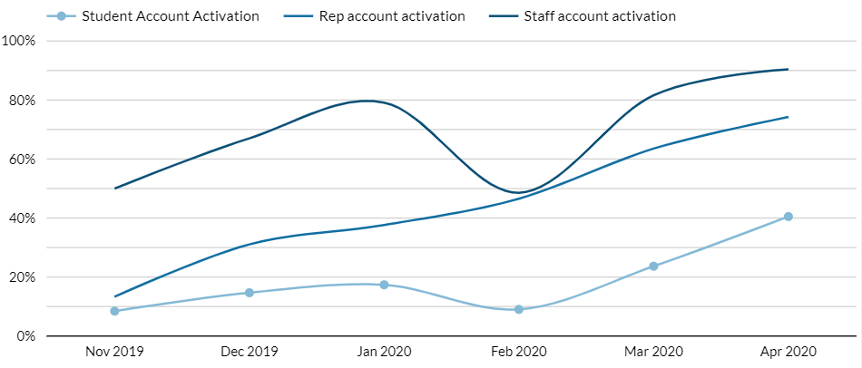
Account Activation (over time)
Pilot
Launch on 14/02

Slide 6
Feedback Engagement
POSTS | VIEWS | VOTES | COMMENTS
647 | 241K | 13.4k | 4.7k

Slide 7
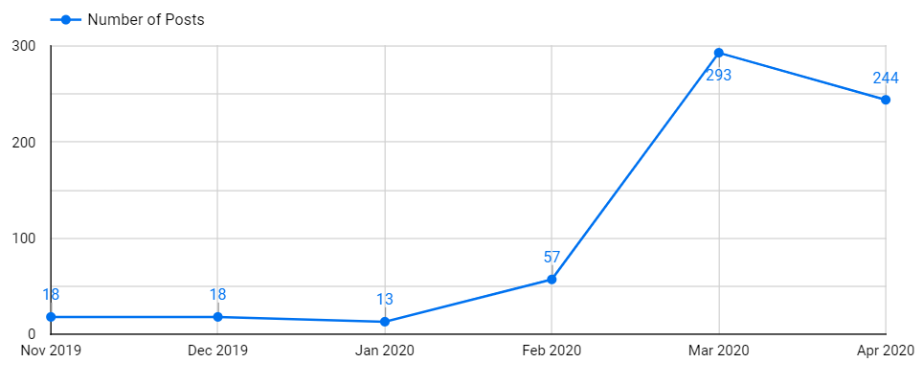
Feedback Posts (over time)
Pilot
Launch on 14/02

Slide 8
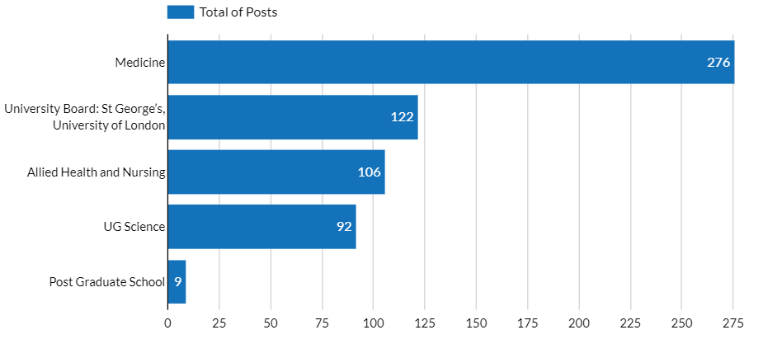
Feedback Posts (across boards)

Slide 9
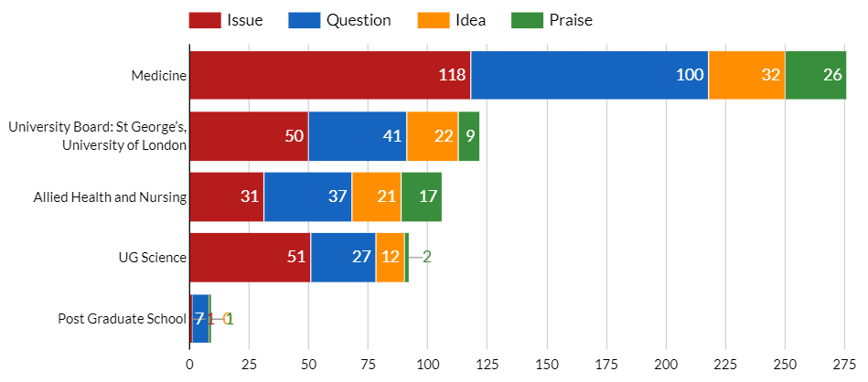
Feedback Posts (across boards + split by type)

Slide 10
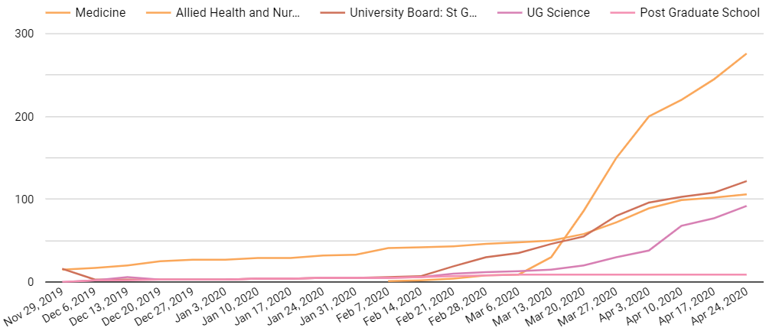
Feedback Posts (across boards + over time)

Slide 11
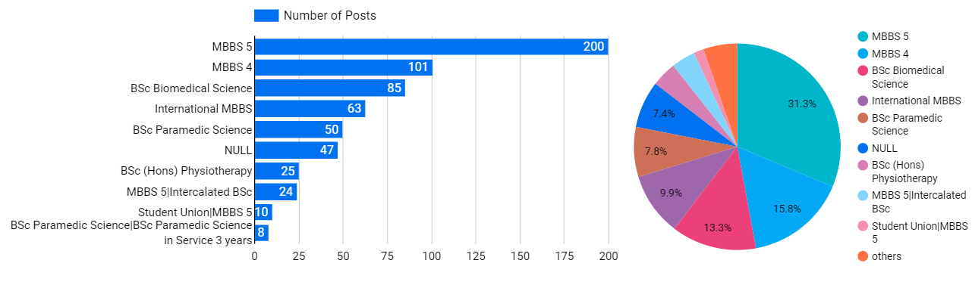
Feedback Posts (across programmes)

Slide 12
Student Engagement
611%
160%
Active students voted
Active students commented
For every student that activated their account they would vote at 6x.
For every student that activated their account they would comment at least once.

Slide 13
Anonymity
Posting
Commenting
15%
32%
85%
68%
Anonymous
Anonymous

Slide 14
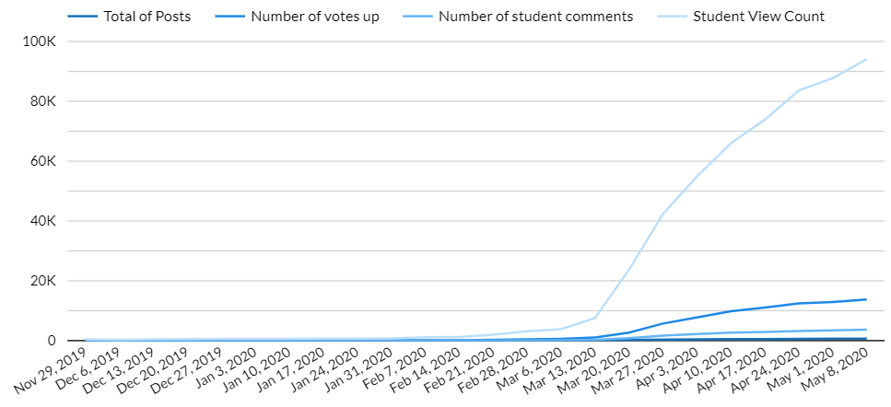
Engagement (over time)

Slide 15
Engagement (across boards and years)
BOARD | POSTS | VIEWS | VOTES | COMMENTS | STAFF C.
Allied Health and Nursing | 112 | 13,254 | 378 | 320 | 110
Medicine | 296 | 153,444 | 7,773 | 2,774 | 480
Post Graduate School | 10 | 423 | 17 | 16 | 9
University Board | 128 | 40,618 | 2,657 | 939 | 258
UG Science | 97 | 33,145 | 2,625 | 641 | 101

Slide 16
Rep Engagement
 | POSTS COMMENTED ON | POSTS CLOSED BY REPS | AVERAGE TIME TO ESCALATE
St Georges, Univ. of London | 30% | 8% | 1 day
Unitu Avg. | 40% | 21% | 5 days

Slide 17
The Rep Impact
BOARD | # REPS | ACTIVE | TRAINED | POSTS (created by reps) | % PRIVATE | % CLOSED
Allied Health and Nursing | 29 | 76% | 3 | 13 | 3% (3) | 18% (20)
Medicine | 21 | 86% | 0 | 6 | 1% (4) | 7% (21)
Post Graduate School | 10 | 40% | 0 | 2 | 10% (1) | 10% (1)
UG Science | 14 | 79% | 2 | 4 | 10% (10) | 5% (5)

Slide 18
Staff Engagement
 | AVG TIME TO FIRST VIEW | AVG TIME TO FIRST REPLY | AVG TIME TO RESOLUTION | % POSTS WITH REPLY
St Georges, Univ. of London | 1 Day | 3 Days | 7 Days | 85%
Unitu Avg. | 2 Days | 4 Days | 12 Days | 79%

Slide 19
Staff Engagement (per board)
DEPARTMENT BOARD | AVG TIME TO FIRST VIEW (days) | AVG TIME TO FIRST REPLY (days) | AVG TIME TO RESOLUTION (days) | % POSTS WITH REPLY
Allied Health and Nursing | 0.9 | 5.0 | 12.3 | 72%
Medicine | 0.6 | 3.2 | 6.4 | 93%
Post Graduate School | null | null | null | 50%
University Board | 0.3 | 1.9 | 7.9 | 90%
UG Science | 0.6 | 3.2 | 6.5 | 67%

Slide 20
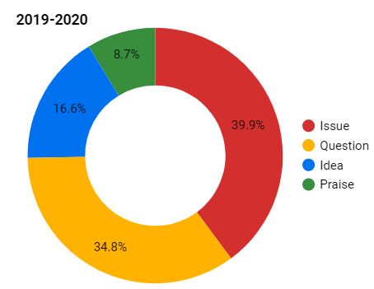
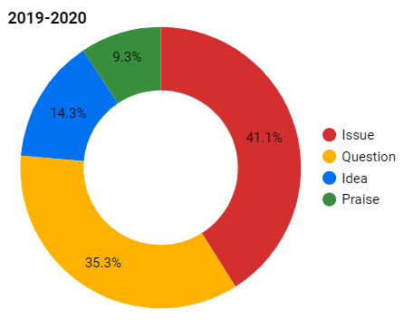
Type of feedback
Unitu Avg.
St Georges, Univ. of London

Slide 21
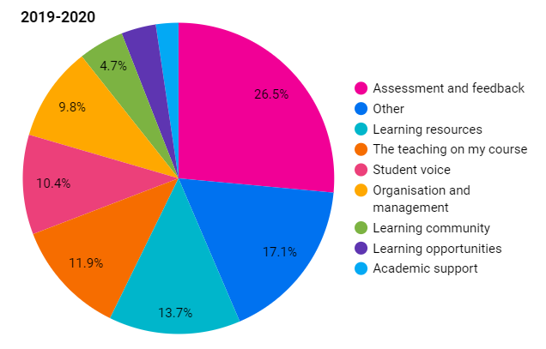
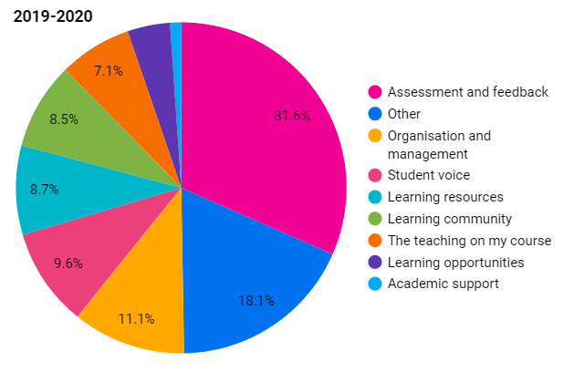
What do students care about (NSS Sections)
Unitu Avg.
St Georges, Univ. of London

Slide 22
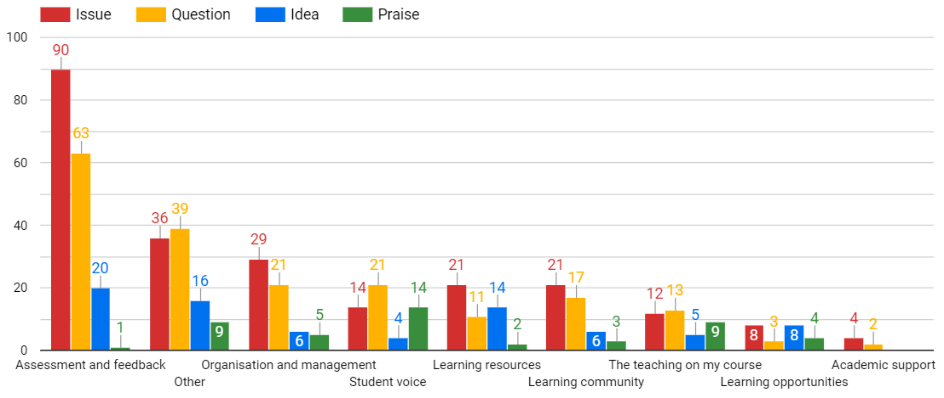
What do students care about (NSS 19-20)

Slide 23
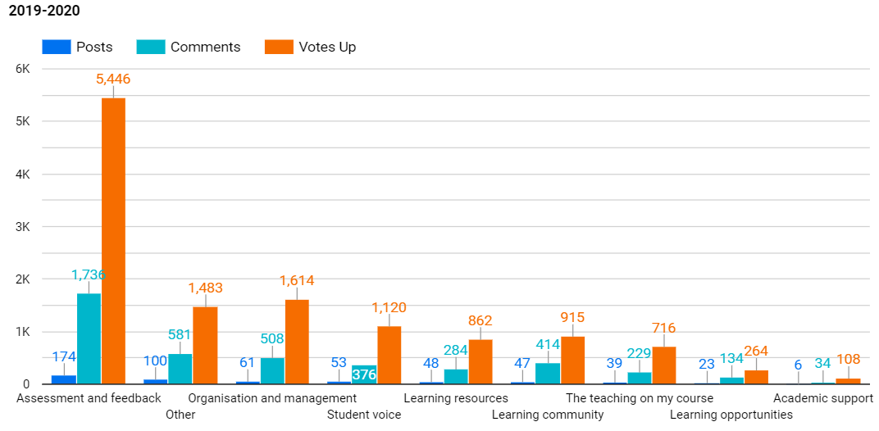
What do students care about (NSS - ‘19-20)

Slide 24
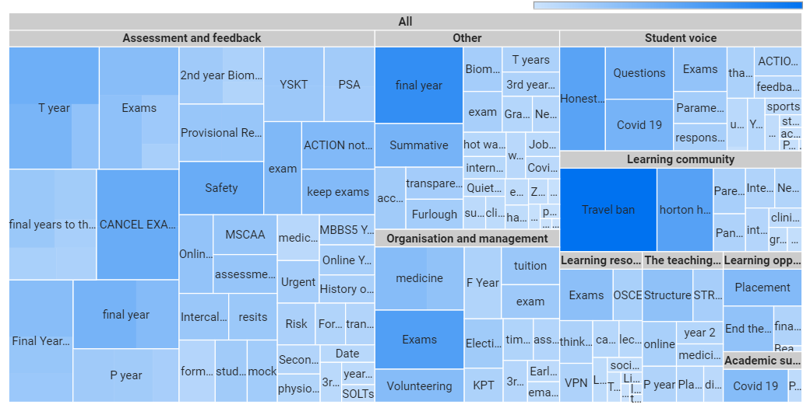
Keyword analysis (by top views and votes)

Slide 25
Most engaged posts for Assessment & Feedback
CHANGE TITLE | CREATION DATE | BOARD | VIEWS | VOTES
Worries over online exams | Mar 17, 2020 | Medicine | 2,950 | 125
Introduce no-detriment policy for the upcoming exams | Mar 31, 2020 | University Board | 2,425 | 180
GMC formal procedure for Final Years to seek guidance - Unified Action | Mar 15, 2020 | Medicine | 1,648 | 42
Exam Details Need to be Emailed now | Apr 14, 2020 | Medicine | 1,619 | 82
Final year assessments | Mar 14, 2020 | Medicine | 1,503 | 37
Formal investigation into St George‚Äôs treatment of their students | Apr 16, 2020 | Medicine | 1,394 | 91
F year KPT - MSCAA crash | Apr 3, 2020 | Medicine | 1,308 | 44
F YEAR KPT, PLEASE CAN YOU SHARE YOUR ONLINE EXPERIENCE TODAY? | Apr 8, 2020 | Medicine | 1,220 | 16
Online Exams - Cheating | Mar 30, 2020 | University Board | 1,202 | 71
Exams | Mar 28, 2020 | UG Science | 1,178 | 113

Slide 26
Most engaged posts for Other (NSS)
CHANGE TITLE | CREATION DATE | BOARD | VIEWS | VOTES
Cancel finals out of respect to student welfare | Mar 13, 2020 | Medicine | 1,667 | 58
Coronavirus KCL , Barts Responses and Lancaster | Mar 13, 2020 | Medicine | 1,268 | 72
GMC guidance | Mar 13, 2020 | Medicine | 1,045 | 40
Covid - 19 Liverpool/Glasgow Response working and cancelling exams | Mar 14, 2020 | Medicine | 993 | 28
Summative Assessments: Pass/Fail vs Decile Rankings | Apr 17, 2020 | Medicine | 938 | 48
Drafting Final Year Medics | Mar 16, 2020 | Medicine | 848 | 14
covid19 | Mar 12, 2020 | Medicine | 805 | 12
HCA Volunteering | Apr 8, 2020 | Medicine | 690 | 40
Final Year Deployment Date..??? | Mar 19, 2020 | Medicine | 657 | 14
PBL Sessions | Mar 13, 2020 | Medicine | 614 | 34

Slide 27
Most engaged posts for Org and Management
CHANGE TITLE | BOARD | Creation date | VIEWS | VOTES
Fellow University of London cancelled PSA due to COVID-19 | Mar 12, 2020 | Medicine | 3,140 | 41
Disappointed to say the least | Mar 20, 2020 | University Board | 1,376 | 89
Unacceptable treatment of students. | Apr 1, 2020 | Medicine | 1,339 | 46
Reimbursement for university tuition fees? | Mar 19, 2020 | University Board | 1,027 | 65
Biomed 3rd year exams | Apr 6, 2020 | UG Science | 837 | 71
MBBS team email response | Apr 3, 2020 | Medicine | 818 | 60
My personal experience as HCA volunteer for St George's | Apr 10, 2020 | University Board | 767 | 58
Can we graduate from the University of London in their colours, rather than St George‚Äôs? | Apr 1, 2020 | University Board | 744 | 25
UK now has the worst death rates in ALL of Europe, give us exam info, so we can try helping | Apr 10, 2020 | Medicine | 740 | 44
t year still no clarity | Apr 4, 2020 | Medicine | 663 | 41

Slide 28
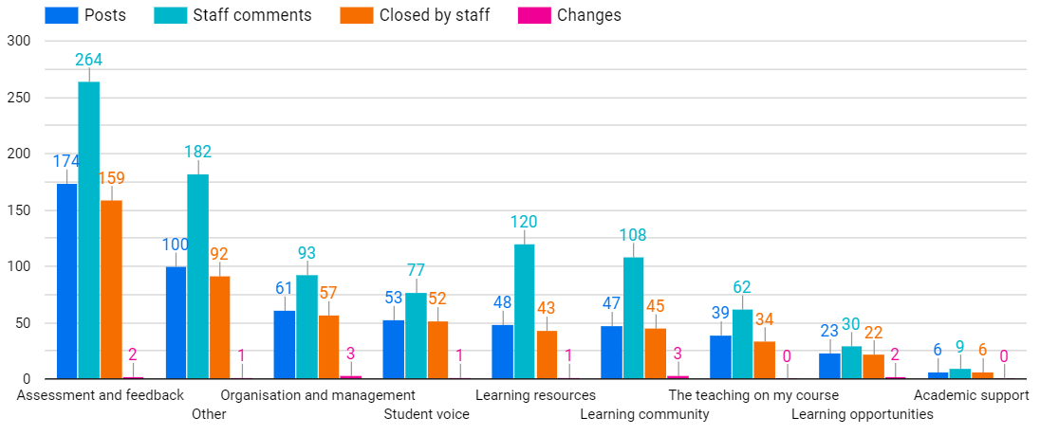
Staff response to posts based on NSS sections

Slide 29
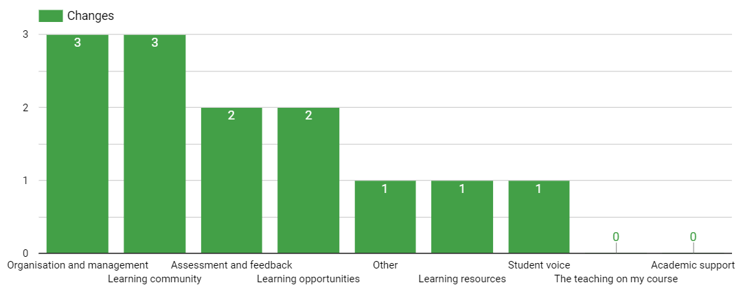
What changes have been made (Overview)

Slide 30
What changes have been made (list per board)
RESOLUTION DATE | CHANGE TITLE | BOARD | NSS CATEGORY
Apr 14, 2020 | If your assessments are deferred, this will be until the next available opportunity. For written exams, we anticipate that this may be in September 2020, but we can’t guarantee this date at the moment.Covid-19-related mitigating circumstances: | UG Science | Organisation and management
Apr 14, 2020 | Requested notice given | UG Science | Organisation and management
Apr 14, 2020 | Detailed assessment guidance given | UG Science | Organisation and management
Apr 14, 2020 | Change to vivas - Year 3 | UG Science | Assessment and feedback
Apr 12, 2020 | Covid-19 training | Medicine | Learning opportunities
Apr 5, 2020 | FY BoE brought forward | Medicine | Assessment and feedback
Apr 3, 2020 | Students offered volunteering opportunity for paid work during Covid period | Allied Health and Nursing | Learning opportunities

Slide 31
What changes have been made (list per board)
RESOLUTION DATE | CHANGE TITLE | BOARD | NSS CATEGORY
Mar 30, 2020 | Students released from contract | University Board | Learning community
Mar 18, 2020 | Microwaves | University Board | Learning community
Mar 13, 2020 | Confidential waste bin | University Board | Other
Feb 20, 2020 | Dissertation similarity check | UG Science | Learning resources
Dec 13, 2019 | Continuing to promote wellbeing for students | Allied Health and Nursing | Learning community
Dec 13, 2019 | Format of ASforP | Allied Health and Nursing | Organisation and management
Dec 9, 2019 | Second year uniform | Allied Health and Nursing | Student voice

Slide 32
Student Voice Impact*
 | I have the right opportunities to provide feedback through Unitu. | I can see how staff value mine and other students’ feedback through Unitu. | It's clear how mine and other students’ feedback has been acted on through Unitu. | On Unitu, there is a sense of community between student, staff and reps
St Georges University (77) | 100% agreed | 78% agreed | 68% agreed | 73% agreed
Unitu (536) | 97% agreed | 85% agreed | 81% agreed | 79% agreed
*Survey was administered by Unitu on 13th May till 28th May to all students using Unitu, a total of 77 St Georges University students responded.

Slide 33
Satisfaction with Unitu*
Unitu (536)
St Georges University
(77)
18%
20%
82%
80%
Satisfied
Satisfied
*Survey was administered by Unitu on 13th May till 28th May to all students using Unitu, a total of 77 St Georges University students responded.

Slide 34
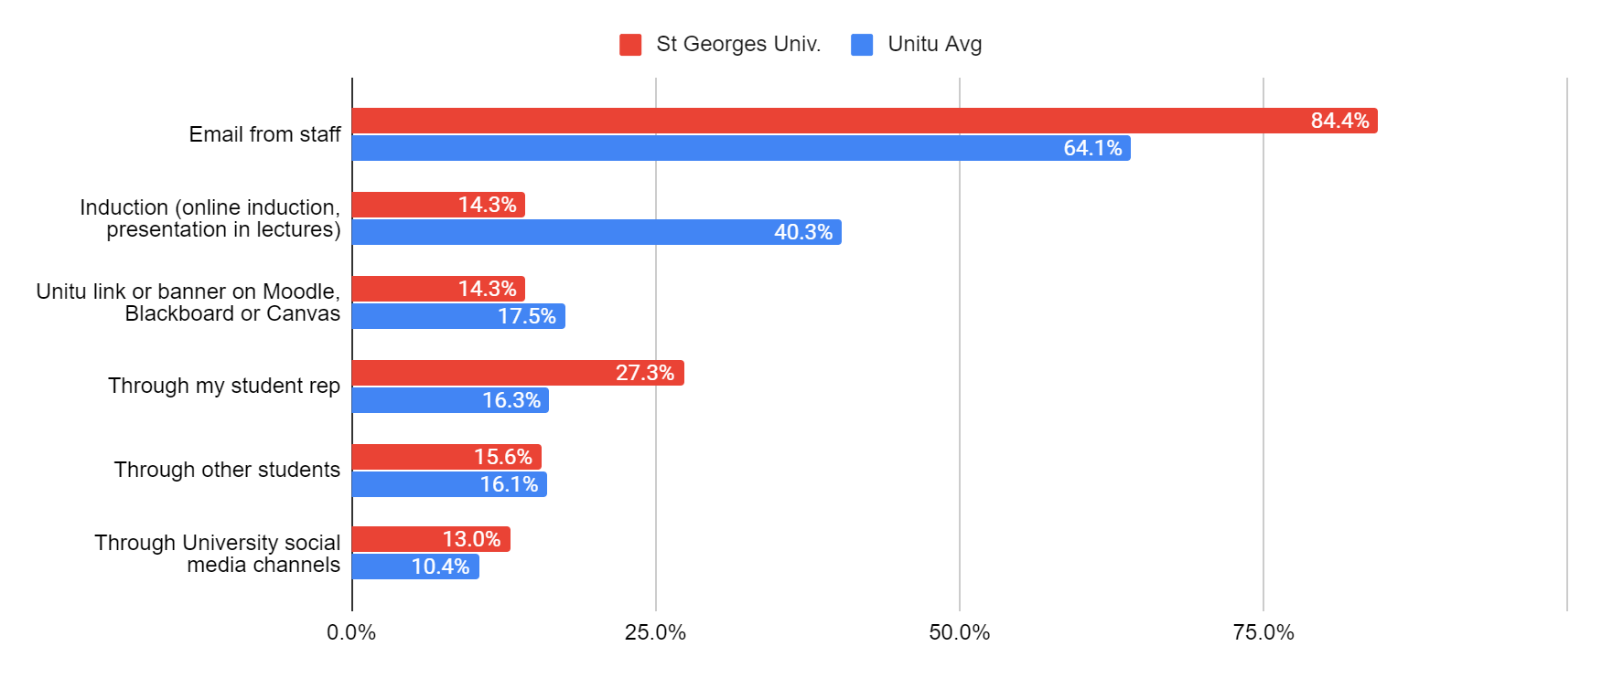
How did you hear about Unitu?*
*Survey was administered by Unitu on 13th May till 28th May to all students using Unitu, a total of 77 St Georges University students responded.

Slide 35
Thank you
Any questions or comments feel free to contact us.
Bruno Morche, Head of Customer Success
bruno@unitu.co.uk

