Slide 1
MBBS Personal Tutor (PT) Training
July 2024
Dr Nicoletta Fossati
MBBS PT Lead
Lee Rolls (MBBS PT administrator)
mbbs_personaltutoradmin@sgul.ac.uk

Slide 2
Personal Tutor meetings - 1
Two compulsory personal tutor meetings per year – part of “Being a Doctor” assessment ​
Recorded via Pebble Pad - Using PebblePad - A Guide for Assessors: Learning Technology for Teaching, Learning & Assessment (sgul.ac.uk) ​
Meetings must be face-to-face (online or in-person) ​
Additional meetings can be requested (as required)

Slide 3
Personal Tutor meetings - 2
Deadlines for compulsory meetings:​
1st meeting before 22nd November 2024 ​
2nd meeting before 11th April 2025 ​
**In Year 1, you may invite all your tutees to a short additional introductory group meeting to ‘meet and greet’ you
Students are sent reminders for the compulsory meetings
It is their responsibility to organise them with you
PT administrator will check if meetings have happened

Slide 4
What will you discuss with your tutee? - 1
You can use the profile form to find out the some of the following about your tutee (especially in the first meeting):
  Where they come from
  Accommodation
  Family support
  Financial issues - part time work
  Physical and mental health
  Friends and social activities
  Interests – academic and recreational
  Ambitions
2nd meeting
  Usually happens after the formative exams in Y1, so discuss those assessments

Slide 5
What will you discuss with your tutee? - 2
Year-specific information – lectures, PBL, learning strategies, practical sessions, exams, SSC-G, GP placements, clinical competency assessments
  Any difficulties? Any support required?
Please ensure any notes made and stored are GDPR compliant:
Lawfulness, fairness, and transparency
Purpose limitation
Data minimisation
Accuracy
Storage limitation
Integrity and confidentiality
Accountability

Slide 6
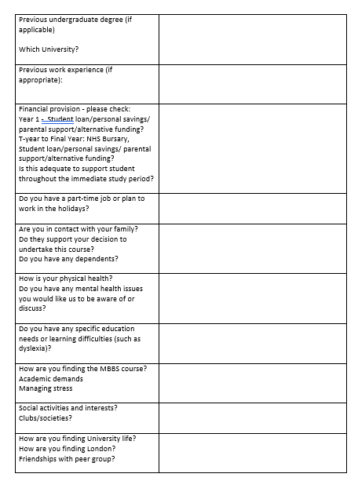
Example of the kinds of questions on the Student information (Profile) form
Completed by Personal Tutor
Retained by PT for information
Not submitted to MBBS Admin

Slide 7
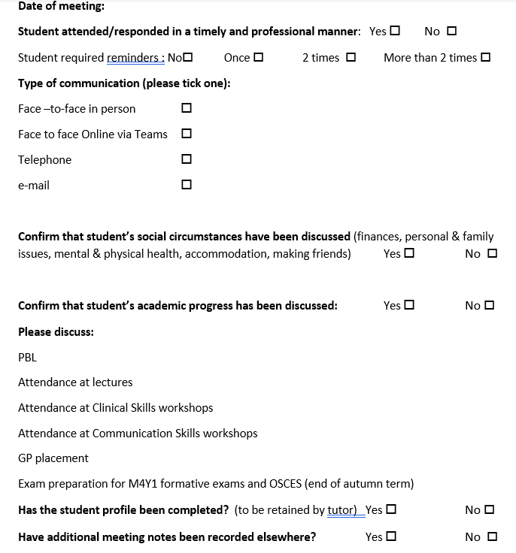
Meeting Form submitted by tutor
Example of M4 Y1 Personal Tutor Form
Tutee sends to Personal Tutor immediately before or after meeting
They have to input the name of the PT and their email address
To be completed by the Personal Tutor, not by student, and submitted
Tutee can check that it has been submitted
Notes:
This is an example of the Myprogress form - it’s a simple tick box form. Remember that your tutor cannot access this so students have to send it to them. The forms will be sent to their electronic devices automatically at the start of every term.
As you can see, it contains some prompts as to what you should discuss, and indicates the main learning events for your year cohort. This will obviously change as you progress into the clinical years.
If you have any problems with this, please contact the Myprogress Team.

Slide 8
Issues raised by students
Lee Rolls (PT Administrator) and students have struggled to get hold of PTs regarding queries by/responding to students
Please ensure you have an “out-of-office” message if required, to manage student expectations
For upcoming SGUL holiday periods, please add in suggested areas of support if students should try and contact you e.g.​
  Togetherall https://togetherall.com/en-gb/resources/ ​
  Student Space Home (studentspace.org.uk) ​
  HOPELINEUK 0800 068 4141​
  Samaritans 116 123 ​
Cost of living crisis – ongoing and more students working​
Accommodation issues – students struggling to find rental properties​

Slide 9
References
Personal Tutors can provide references at their discretion for:​
Part time work​
Applications for grants from charities​
Foundation programme in Final Year - academic reference ​
Final Year Elective (also act as Home Tutor if required for students undertaking elective outside UK)​
Character reference or acting as advocates if students need support for Mitigating Circumstances or Discretionary Panel or Disciplinary hearing​
Students should ask in good time​
NB: Personal Tutors do not provide references for landlords or financial institutions ​
Students should ask Accommodation or Finance Advisor in Student Centre
Notes:
I mentioned references earlier – you may be asked for a reference for part-time work, or a voluntary job, an academic course or an external opportunity such as an elective placement or to apply for a conference. You will all need an academic reference for your applications for Foundation Programme in Final Year and you can ask your personal tutors to do this.
They may also provide a supporting statement should you need it for mitigating circumstances or an appeal.
Personal tutors do not however provide references for landlords and you will need to contact the accommodation about this. Likewise they don’t provide references to financial institutions and you will need to discuss this with the Finance adviser.
The key thing here is to ask in good time, and make sure your personal tutor knows you well enough to be able to do this.

Slide 10
Confidentiality
Personal matters discussed with your tutee are treated as confidential within the Welfare Team and will not usually be disclosed to other people.
Personal Tutors may breach confidentiality if:
  Student may be at risk of harm from self or others
  Student is a risk to self or others
  Illegal activity is involved
Under these circumstances, tutors are expected to consult with the senior Welfare Team
Personal tutors are not counsellors - you can suggest students refer themselves to the Counselling Service as required
Personal tutors may occasionally need to seek advice from more experienced staff on the Welfare Team. This is usually done with the consent of the student, or anonymously, i.e., without naming the student
Notes:
Conversations with your personal tutor are private and confidential. However, there are some important exceptions to this.
Personal tutors are expected to inform a senior members of the welfare team if they think that the student is at risk of harm from themselves or someone else, or if there is a risk they may harm someone else, or if they are involved in illegal activity.
The senior welfare team involves the PT lead for MBBS, the Personal Tutor Co-Ordinator Dr Suman Rice, Dr Jane Cronin-Davis, the Dean for Student Welfare, and sometimes Gavin Taylor (Head of Student Services) from the Student Centre.
Personal tutors may seek advice from within the welfare team if they feel it is necessary because they may need some advice from more experienced staff in order to provide appropriate support.
Any sharing of information is usually done with the consent of the student, but tutors may also some times also do this without naming the student. Tutors are not counsellors so they may need to seek advice on how to manage certain situations and problems.

Slide 11
Teaching diary and Super Tutor role
Standard allocation 4 hours per tutee
Super Tutor - additional 8 hours allocation in teaching diary
This role is applicable if you have had a tutee who has required a lot of additional input due to complex issues and must be known to MBBS welfare support team (liase with Lea Stock)
Keep log of meetings
Please contact NF/SR if you think this applies to you

Slide 12
F-year reflective component
Aim: to encourage Final Year students to reflect on their professional identity and career plans as they come to the end of this phase of their medical training
When: at compulsory first PT meeting in F-year
Included as relevant tick box on PebblePad form - ‘encourage tutees to reflect on their professional identity and career aspirations’
Feedback from 2024-25 – to Dr Emma Metters emetters@sgul.ac.uk

Slide 13
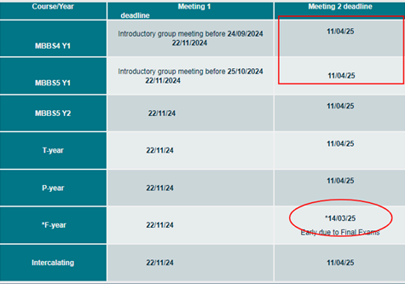
PT-tutee meeting dates
Suggest to meet with Y1 students quite soon after the formative exam results to discuss study skills and strategies

Slide 14


