Slide 1
Translating the Latest Assessment and Feedback Research Literature into Practice
Edd Pitt, PhD SFHEA and
Kathleen M. Quinlan, PhD PFHEA
Centre for the Study of Higher Education,
University of Kent
Notes:
Introduce ourselves. We will present the aims of the review and the methods we used, then Kathleen will present on Assessment and pause to respond to questions. Then Edd will present about feedback and peer feedback before taking another round of questions.
Feel free to add questions in the chat – the author who is not presenting will monitor the chat and collect questions to pass on to the presenting author.

Slide 2
Systematic literature Review
Pitt & Quinlan (2022)
Notes:
EDD

Slide 3
Aim of the Review
Evidence-based assessment and feedback policy and practice in HE
2016- 2021
Demonstrable impact on student outcomes
Satisfaction
Engagement
Performance
Notes:
EDD The review is part of a series of reviews commissioned over the course of about a year on various parts of Advance HE’s student success framework, intended to update evidence reviews published in 2015-16.
We were charged with reviewing literature published between 2016 and 2021 on policy and practice in assessment and feedback that had a demonstrable impact on students’ satisfaction, engagement or performance – that is their learning variously defined.
The review is intended to help practitioners, policy makers and researchers to focus more effectively on relevant questions, issues or sources of evidence to inform their own research or practice and was guided by the Advance HE (2015) Transforming Assessment in Higher Education Framework

Slide 4
Review of Empirical Articles
Notes:
EDD It was a systematic literature review that was initially overinclusive, yielding 3,091 articles.
A full text review reduced the number of included empirical articles to 481 which we coded into the following three major categories, which divided the review into three major headings: assessment, feedback practices and peer assessment/peer feedback based on both the way the literature is often siloed and the structure of the Advance HE framework.

Slide 5
Notes:
EDD

Slide 6
assessment
Notes:
KATHLEEN: By number of articles, assessment was the largest of the three sub-areas of the review and the first area we address in the written review and in this presentation. I led on the Assessment section, while Edd led on the feedback section and the peer assessment/peer feedback section. We divided the literature into these three areas because they matched the Advance HE Assessment Framework and these categories worked well with the literature – it was relatively straightforward to code them across these three main headings.

Slide 7
Defining Assessment
‘Learners engage in tasks, which generate data” which form evidence from which inferences or claims can be made about learning.
(Black and William, 2018)
Notes:
The first matter that needed to be clarified was the definition of assessment. Some definitions of assessment focus more on summative assessment – that is, seeing it as a process by which academics assure academic standards. But we – and the bulk of the literature reviewed - focussed more heavily on assessment FOR learning, rather than assessment OF learning. That is, assessment should be about promoting students’ learning. We draw on Black and William’s definition of assessment as when ‘Learners engage in tasks, which generate data” – some kind of an observable output from which inferences or claims are made about student learning. (Black and Wiliam, 2018, 553). So, basically, assessment is when students DO something that they and others can then observe and draw some conclusions about. Thus assessment – defined broadly in this way - can occur anywhere in the instructional cycle, it can be written, verbal, individual, or group-based, it can be as small as answering a question in a seminar or as big as a year-long research project. It can count toward a students’ mark or it might not.
Think of student activity – design FOR student to DO something and have opportunities to have feedback on that activity – whether from a computer, from peers, from a client, from themselves or, possibly from you. This broadened definition is vital to translating the research into enhanced educational practice.

Slide 8
Recommendations for Practitioners - Assessment
Incorporate groupwork across each student’s programme
4
Incorporate at least one high -impact practice into each student’s experience
3
Use, evaluate and refine authentic assessments
2
Align assessments to desired learning outcomes
1
Notes:
KATHLEEN We won’t present all of those recommendations here, but just touch briefly on seven key ones. 4 for assessment and 4 for feedback.

Slide 9
1) Align Assessments to Desired Learning Outcomes – Backward Design
Notes:
Usual SEQUENCE of TEACHING is learning activities (teaching), then assessment, then students have some outcomes.
BUT, when designing assessment and feedback activities,
we need to start at the END – determine what want students to be ABLE to do, then design assessment that provides evidence that that they can do so and then design learning activities that allow them to practice those things you want to assess.

Slide 10
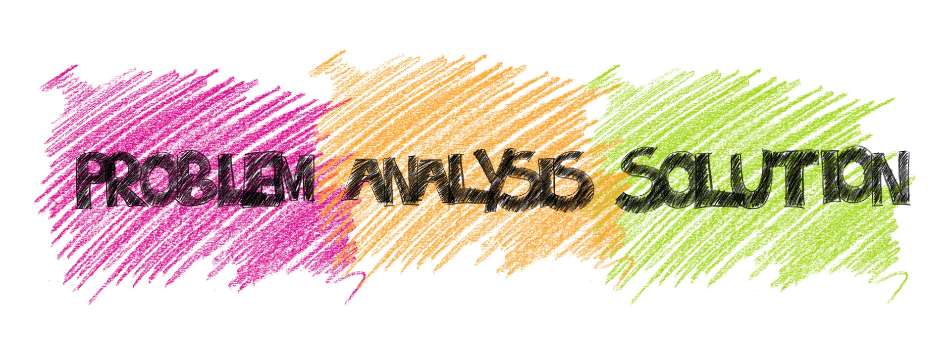
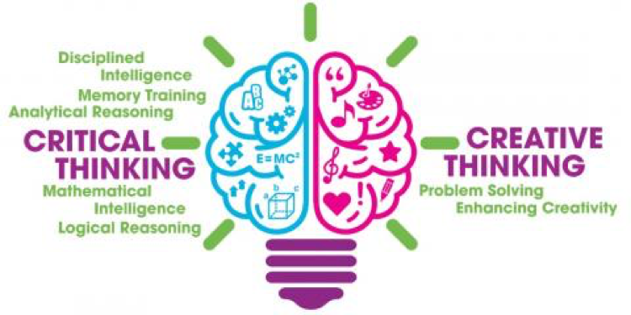
1) Align Assessments to Desired Learning Outcomes – Goals/Objectives
What do you want students to be able to DO as a result of your programme? Your module?
Notes:
When our students graduate what will they be doing?

Slide 11
2) Use, Evaluate and Refine Authentic Assessments
Challenging
Real world application
Develops evaluative judgment
(Villarroel et al, 2018; Sokhanvar et al, 2021 ; Simpson, 2019)
Notes:
KATHLEEN We want to unpick the 2nd and 3rd assessment-related recommendations in greater depth as that served as the foundation for the new Superchargers Resource we are launching. Authentic assessments have gotten a lot of press lately. In the review, we used Villarroel’s definition of authentic assessment as challenging, offer real world application and develop evaluative judgment – with some key enhancements.
First should be challenging – Villarroel and others emphasise cognitive challenge, but we can also consider situations that involve emotional or ethical challenges – as well as cognitive challenge - to be authentic.
Authentic assessment has been defined in various ways, but we build on and extend Villarroel et al’s (2018) principles that define authentic assessment. They defined assessments as involving realism or real world application, which emphasises the relevance of assessment activities, topics, or processes to the “real world”. Normally that tends to emphasise employment contexts, but it can refer to any real-world activity which also opens up the possibility of connecting to larger issues like sustainability or social justice that may not be foregrounded in a particular career, but which require the application of higher education knowledge and skills and which students are often very concerned about.
Third, authentic assessments help students to develop an understanding of what constitutes quality in a field and grows their ability to make that judgment about their own and others’ work.
There was considerable evidence to support the introduction of greater authenticity into students’ assessments – it seems to improve students’ satisfaction, engagement and learning.
For example, in the UK, Simpson compared students’ pass rates before and after introducing case based scenarios into assessments in a business course and found increases in enjoyment ratings and in pass rates.
OSCEs are also a form of authentic assessment.

Slide 12
3) Incorporate at least one high impact practice in Each Student’s Experience
Challenging (set high expectations)
Sustained student effort
Meaningful interactions
Working with diverse others
Feedback
Real world application
Public demonstration of competence
Reflection on and integration of learning
(Kuh and O’Donnell, 2013; Kuh, O’Donnell & Schneider, 2017)
Notes:
High Impact practices are instructional practices that are defined by eight key principles or elements: high expectations of learners, sustained student effort, meaningful academic and peer interaction, students working with diverse others, timely and constructive feedback, real world application, public demonstration of competence, and reflection on and integration of learning (Kuh and O’Donnell, 2013). So, by definition a high impact practice integrally involves assessment – specifically a public demonstration. That is, student work is seen by someone other than the teacher – such as a community member, a client, a user of a service, or a stakeholder in the students’ action.
These practices include capstone courses, internships or work-integrated learning/work-based learning, community service learning, and undergraduate research projects (Kuh, O’Donnell & Schneider, 2017). All of them have considerable evidence drawn from large scale correlational datasets based on the US National Survey of Student Engagement.

Slide 13
E.g. Work-integrated learning
This Photo by Unknown Author is licensed under CC BY
(Kaider et al, 2017; Valenzuela et al, 2018; Schonell and Macklin, 2019)
Notes:
In the review, we particularly highlighted work-integrated learning and discussed examples of how work-integrated learning activities might be assessed for the purpose of assigning a grade. Some work-integrated learning takes students to the workplace. When doing so, attention still needs to be paid to how those activities are summatively assessed. Alignment between assessment and intended learning outcomes is essential. For example, several studies emphasised the role of practical tests – and of scaffolding students to being able to do the real tasks required on the job, whether that was being able to read an X-ray in a clinical radiology mini-placement or issuing an order or a verdict regarding a case in a law setting. Others have used oral exams and portfolios to assess students’ abilities to identify opportunities in a practice setting.
Because it is hard to provide all students with placement opportunities, one important area for attention is – in effect – bringing the workplace to students through what are called live business cases, client-initiated or client-sponsored projects, live case studies or collaborative industry-led projects or in the more design-oriented fields “live briefs”. Basically, clients are lined up with a real problem they need advice or assistance on. Students are formed into groups to research this problem, analyse possible solutions and present those to the client at the end of a module. The students may visit the business or organisation, interview members of the business or their clients or product users, gather examples from elsewhere in that sector or industry, and so on.
These live case studies integrate the eight elements of high impact practice, but offer that rich learning experience to a whole cohort – even across large class sizes. When they are structured as group projects, they are also more efficient to mark. Because students are more interested in the work – they see how it connects to the real world and builds skills they will need in their own careers – they are more satisfied and engaged. Live cases seem to be effective, particularly when attending to the lessons highlighted in the literature. For example, they typically depend upon students working in groups and being assigned a group grade.
As I’ll talk more about in a few minutes, students may need explicit instruction and supports to work effectively in groups. Ensuring individual accountability is vital; there are various ways that researcher-practitioners built in individual accountability into the marking process. For example, Schonell and Macklin (2019) introduced meeting minutes and reports on task allocations and completions as one way in which individual contributions could be managed, tracked and marked. Adding this element seemed to contribute to both learning and satisfaction. Live cases were common in business. A challenge to the sector is to introduce these kinds of activities into a wider range of disciplines.

Slide 14
4) Incorporate GroupWork Across each Student’s Programme
Clarify purpose
Set group goals (group mark)
Assign groups
Teach/scaffold collaboration skills
Ensure individual accountability (individual marks)
(McGahan et al, 2016; Paschalis, 2017; Taylor et al, 2021; Sedghi & Richworth, 2017; Gamlath, 2021; Morley and Ablett, 2017;Leung, 2017; Paschalis, 2017)
Notes:
Because team working and collaboration are often cited as key skills students will need in their future employment, group assessment can be a form of authentic assessment. Group assessments may also help promote social integration, which is associated with greater retention IF teachers assign students to mixed groups rather than relying on self selection. When done well, it also is cost-saving in terms of teacher marking time. Gamlath (2021) studied 98 modules in an Australian business school, of which 35 had group-based assessments. Student progression was higher in modules with group assessments and the effect was stronger with higher weighting of group assessment. But they also found that student satisfaction was lower in units with group assessments.
To achieve high student satisfaction, engagement and learning, groupwork needs to be carefully designed and the evidence supported several key design features. First, student perceptions of group assessments, like other assessment tasks, is improved by clarifying the task and its purpose and value (Sedghi and Rushworth, 2017). Second, obviously, for it to be a group assessment, there needs to be a group goal – usually a group product. Several studies emphasised the importance of randomly grouping students into groups or to teacher assigned groups, rather than student selected. Students’ need to be prepared for those tasks, including scaffolding of new skills or attitudes required for success (McGahan et al, 2016; Paschalis, 2017; Taylor et al, 2021). And, perhaps most important to ensure equitable contributions across the team and avoid friction within the team, there needs to be a way to ensure individual accountability by assigning marks to students’ documented contributions. Morley and Ablett (2017) designed and evaluated the impact of assessed group work on a diverse cohort of first year students in an Australian social work programme. In one study, 70% of the groupwork mark was allocated for self- and peer-assessed individual contribution and 30% for the quality of the group’s final product. This group work experience led to students feeling more connected to their classmates and a greater sense of belonging (Morley and Ablett, 2017).

Slide 15
( Hancock et al, 2018; https://peerwise.cs.auckland.ac.nz/)
Notes:
A Web 2.0 platform called PeerWise has now become common to facilitate students’ engagement in assessment co-creation, as well as peer feedback/assessment activities. In PeerWise, students construct their own Multiple Choice Questions, share those with peers, and get feedback from peers.
These studies suggest that short, low-weighted use of PeerWise can have demonstrable impact on students’ learning, particularly for low achievers. It is particularly effective if the peer-review/peer feedback affordances are incentivised. Basically, PeerWise facilitates peer dialogue about the substantive content and hones students’ critical evaluation skills, while also allowing them to rehearse and elaborate the content.
-------------------------
In a robust study with large student numbers (n=1,200), internal and external controls, and researcher-rated levels of student engagement, Hancock et al (2018) concluded that student engagement with PeerWise results in an average mark uplift of 4%. Students were assigned to both generate and peer review MCQs. The better the engagement, the greater the gains students made on those topics. PeerWise engagement benefited students across the ability spectrum, and particularly those at the lower end. Having been trained on generating good quality MCQs that test higher order thinking, student questions were often high-quality and engaged students in dialogue about the substantive content.

Slide 16
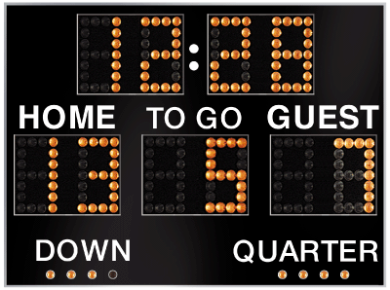
Gamified Learning
Design Collaborative-Competitive Structures
(Sailer and Homner, 2020; Eltahir et al, 2020; Guardia et al, 2018; Wilkinson et al, 2020; Sailer and Sailer, 2021; https://kahoot.com/; https://www.quizalize.com/)
Notes:
Traditional multiple choice assessments like those used in automated assessments or in audience or personal response systems (such as Socrative, Plickers and Mentimeter and Google slides) can be enhanced by adding game-like elements as has been done in quiz programmes such as Kahoot! and Quizalize.
As with automated assessments, quiz games enable immediate task-based feedback, which is powerful. We found good evidence for small, but significant effects of gamification on learning, particularly cognitive learning outcomes.
Motivation and behavior was also increased by the use of collaborative-competitive structures. That is, it works better when educators put students into teams to work together while competing with other teams – using features such as leaderboards that display team scores. So, again, we see the importance of the social dimension – promoting meaningful peer interactions that keeps coming up.
Adding gamification into traditional assessment activities such as quizzes is likely to yield small benefits to students, particularly in terms of knowledge gains. However, the type of gamified quizzes described above may not address higher order thinking skills so is not set to transform assessment in the way that some of the other activities such as simulations or portfolios might do. Still, in subjects where much information simply needs to be learned and recalled – like anatomy or vocabulary – it is a valuable tool.
----------------------------
A meta-analysis and a few further robust studies found small, significant effects of gamification on cognitive, motivational and behavioural learning outcomes, though only collaborative-competitive structures affected their motivation and behavioral learning outcomes.

Slide 17
Notes:
EDD

Slide 18
Defining Feedback
A1
Winstone and Carless, (2019); Winstone, Pitt & Nash, (2021)
Notes:
EDD

Slide 19
Shift the culture of feedback to emphasise and support students’ use of feedback
1
Treat feedback as part of an ongoing, positive relationship, not a one-off event
2
Increase opportunities for peer assessment and peer feedback
3
Recommendations for practitioners - Feedback
Notes:
EDD

Slide 20
Van der Kleij, Adie & Cumming, (2019) Winstone & Carless ( 2019)
Notes:
We saw research attesting to the virtues of educators and students engaging in ongoing dialogue surrounding enactment of feedback and refinement of work in progress (Carless and Boud, 2018; Dawson et al, 2019; Pitt and Carless, 2021). Yet, studies continued to show that students expect educators to give them high-quality information and guidance without considering their own role in the process (van der Kleij, Adie and Cumming, 2019; Winstone and Carless, 2019).

Slide 21
FEEDBACK
Esterhazy & Damsa (2019), Pitt & Carless (2021)
Notes:
Esterhazy and Damsa (2019)
20-week undergraduate biology course at a large Norwegian university.
Students completed three group assignments and participated in several iterative written feedback episodes with their peers and the educator. It was the same assignment honed over and over again with peer and teacher feedback throughout a term. 3 assignments completed and for each one students met 5 times per assignment over an 18 week period
Students’ interactions with each other, their teacher, and the available resources mediated how students advanced their understanding of their discipline.
Through the curriculum and feedback exchanges, they had opportunities to enact feedback, self-evaluate and improve future work.
Educators created a culture of students finding solutions for themselves rather than telling them the answers, prompting students’ responsibility for meaning making and acting on feedback.

Slide 22
Workshop – Creating Feedback Opportunities within the Curriculum: Leveraging time to maximise the impact
Content
Opportunities for Feedback
Keshavarz and Köseoǧlu (2021)
Notes:
“a letter to my teacher” activity

Slide 23
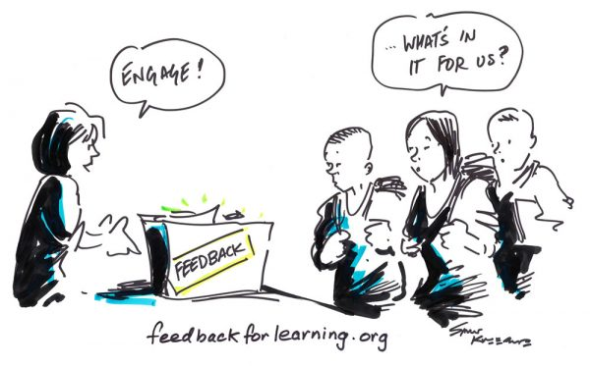
Mulliner & Tucker (2017)
Notes:
Mulliner and Tucker (2017) found most students (93%) said they always acted on feedback, and 72% agreed they understood how to make best use of their feedback. In contrast, only 4% of educators thought students always acted on feedback (Mulliner and Tucker, 2017)

Slide 24
Vattøy et al(2021)
Specific
Understandable
Actionable
Prior to submission

Slide 25
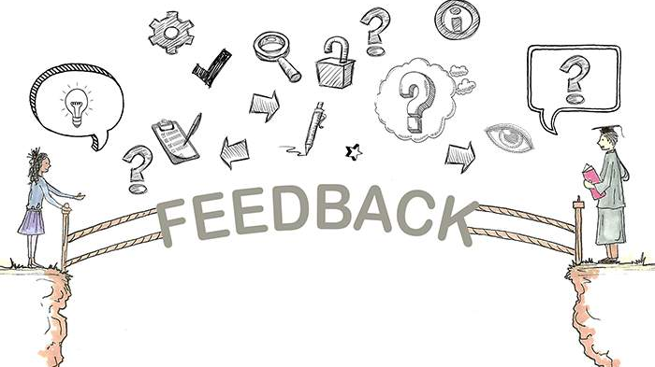
ONGOING
OPPORTUNITIES

Slide 26
EXEMPLARS
Carless & Chan (2017), Panadero & Jonsson (2020), To, Panadero & Carless (2021)

Slide 27
HUNUKMBRE ET AL (2017)
3RD YEAR MEDICAL STUDENTS
DURING SUMMATIVE OSCE

Slide 28
Peer Feedback
It is better to
Give than
Receive
Huisman et al (2018), Huisman et al (2019)

Slide 29
technology enhanced Feedback
Cavaleri et al (2019
Notes:
Video feedback seems to be different from written feedback in several ways that may explain its effectiveness.
In Australia Cavaleri, et al (2019) evaluated whether audio and video feedback helped students engage with the feedback more successfully than conventional written methods. submitted two draft assignments to the advisor for language and literacy feedback.
One of their papers received written feedback via the comments feature in MS Word. The other paper received audio-visual feedback, which included screen capture video feedback, audio commentary and minimal written comments.
The students then redrafted their work for summative submission.
77% of the written-only feedback was used in a subsequent revision, compared to 88% of the video feedback.
When students received video feedback they were 2.17 times more likely to make successful changes to their work than written feedback alone.
This intervention seems to have had the most profound effect on students at the lower end of the grade spectrum. When receiving written feedback, lower achievers address only 53% of the feedback comments, compared to 78% when they received video feedback. Thus, video feedback may be an important element in closing attainment gaps.

Slide 30
How Do we Enhance Assessment and Feedback Practice?
Notes:
KATHLEEN In the end, we had a weighty document. We concluded our review by drawing out 21 practical recommendations, divided into those focused on practitioners, policy makers and researchers. We will briefly summarise three to four practitioner-focused headline recommendations for each of assessment and feedback in a moment.
But our real aim – and Advance HE’s aim with the review - is to enhance assessment and feedback practice.
As we found, there are literally thousands of articles that have been written on this subject and many conferences of the type we are having today that showcase good practices. But many of the same practices – and underlying beliefs that support those traditional practices – are often unchanged at the coal face.
We recognise that there are many structural barriers to implementing the good practices identified in the review. But, with creativity and commitment, there is still room for academics to make many enhancements.
So, we asked ourselves – what more can we do to help academics at the coal face to use these insights from research to change their practice?
How many of you are in a position to influence others assessment and feedback practice? That might be as educational developers or it may be as Directors of Studies or course or module leads where you are socialising graduate teaching assistants? Raise your hand. Keep your hand up.
Now, how many of you are in a position to design A and F in your own courses or modules? Raise your hands. So most of us in the room can benefit from understanding how to translate research into practice.

Slide 31
Supercharge Assessment & Feedback
A1
Notes:
KATHLEEN We can think of authentic assessments as being like a basic, three ingredient SALAD – lettuce, tomato and cucumber is nutritious and healthy. We want to encourage that!
But we can also supercharge this basic salad with other ingredients. Avocado, corn, beets, some protein – all kinds of good stuff that makes it both tastier AND more nutritious. A superfood lunch!
Likewise we drew on the principles of high impact practices to envision supercharged assessment and feedback practices. From this, we developed our idea of the new Superchargers’ Resource.

Slide 32
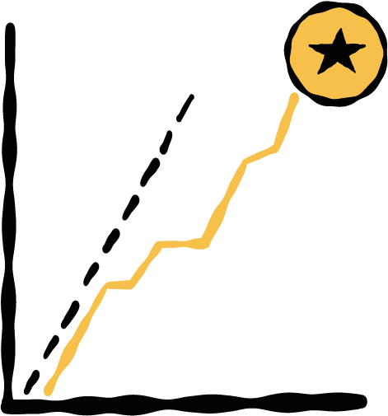
PRINCIPLES OF HIGH
IMPACT PRACTICES
Pitt & Quinlan (2023)
Meaningful Interactions
High Expectations
Real World Application
Feedback
Sustained Student Effort
Working with Others
Public Display of Competence
Reflection
Notes:
KATHLEEN Because our focus is assessment FOR learning, our key question is the extent to which any given assessment or feedback practice promotes learning. It was helpful to think in terms of underlying learning principles because it helped to categorise different practices, critique the practices and the research based on them, and explain effects of various particular assessment practices.
For that, we looked at the principles underpinning
High Impact practices such as capstone courses, internships or work-integrated learning/work-based learning, community service learning, and undergraduate research projects (Kuh, O’Donnell & Schneider, 2017). All of them have considerable evidence drawn from large scale datasets based on the US National Survey of Student Engagement, among others.
High impact practices are defined by eight key principles or elements: high expectations of learners, real world application, integrated constructive feedback, meaningful academic and peer interactions, sustained student effort, students working with diverse others, public demonstration of competence, and reflection on and integration of learning (Kuh and O’Donnell, 2013). Traditional high impact practices – such as service learning or undergraduate research projects involve all 8 principles. But it is possible to “supercharge” normal, day-to-day assessments by simply adding practices that exemplify further principles.
Some of these principles match authentic assessments as we just defined them – the three ingredient salad – high expectations and sustained student effort implies challenge; real world application; and reflection and feedback are needed for the development of evaluative expertise.
However, the other elements add further dimensions that also allow us to integrate the recommendations related to assessment and those related to feedback.
Principles are valuable because they allow us to integrate a lot of different kinds of activities under higher level headings to synthesise evidence and communicate across subjects.
But principles are very abstracted – it is all well and good to say “add meaningful interactions” just as it is easy to say that feedback should be dialogic or ongoing. But many academics still don’t know HOW to put that into practice within the constraints of their own teaching environments.

Slide 33
Game Like Interactive Workshops
A1
Notes:
KATHLEEN: We designed these into the Superchargers Resource, which includes eight decks of cards, with 5-10 specific examples of how to implement the principle. Participants discuss these cards in relation to specific scenarios to develop action plans for enhancing assessment and feedback practices. As you go through the day today, listen for which of the key principles are being integrated into the innovations you are learning about. The workshop this afternoon is a shortened version of the full Superchargers’ Workshop.

Slide 34
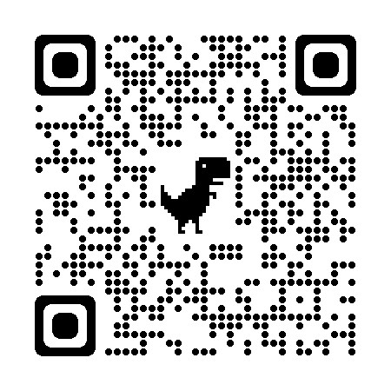
Questions????
USEFUL LINKS & REFERENCES
Pitt & Quinlan (2022)
Literature Review
Assessment & Feedback Superchargers
Thank you to:
Advance HE for the funding to develop the Literature Review and Assessment and Feedback Superchargers Resource,
particularly Stuart Norton

